Slide 1
CRASH COURSE
MACHINE LEARNING IN DATA SCIENCE

Slide 2
AGENDA
Introduction to Machine Learning
Need for Machine Learning - Supervised and non-Supervised Learning Algorithm
Predicting a continuous value using – Regression
goodness-of-fit measure – R-squared

Slide 3
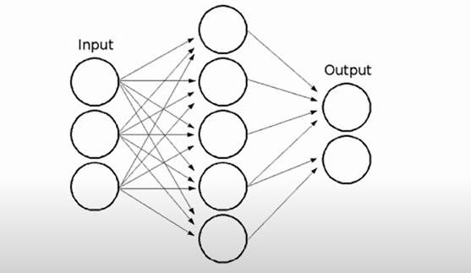
Introduction to Machine Learning
What is Machine Learning?
Machine learning is a set of techniques to make computers better at doing things that humans (conventionally) can do better than machines.
It involves making machines learn things like humans do.
Machine learning(M.L) is the study of computer algorithms that improve automatically through experience and using data.
Notes:
. What is Machine Learning?
Machine learning (ML) is the study of computer algorithms that improve automatically through experience and using data. It is seen as a part of artificial intelligence. Machine learning algorithms build a model based on sample data, known as "training data", to make predictions or decisions without being explicitly programmed to do so. Machine learning algorithms are used in a wide variety of applications, such as in medicine, email filtering, and computer vision, where it is difficult or unfeasible to develop conventional algorithms to perform the needed tasks.
A subset of machine learning is closely related to computational statistics, which focuses on making predictions using computers; but not all machine learning is statistical learning. The study of mathematical optimization delivers methods, theory and application domains to the field of machine learning. Data mining is a related field of study, focusing on exploratory data analysis through unsupervised learning. In its application across business problems, machine learning is also referred to as predictive analytics

Slide 4
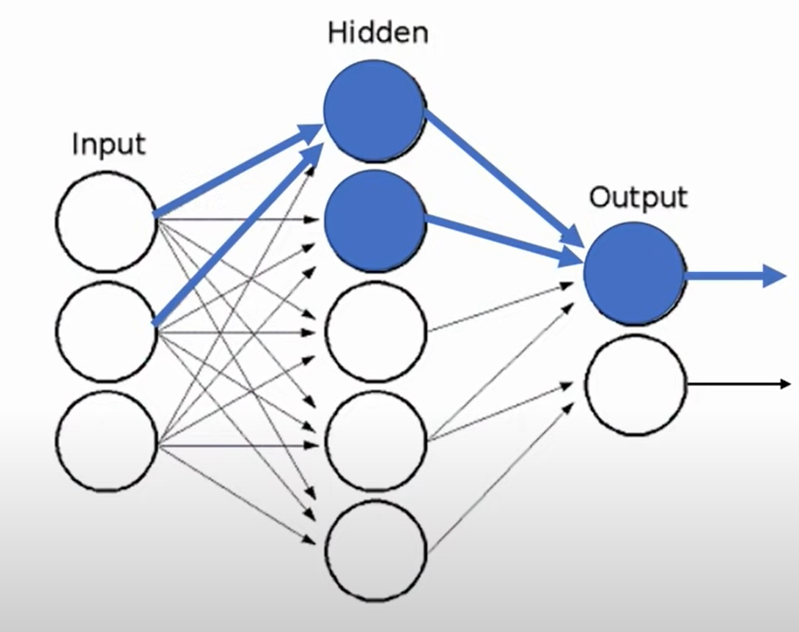
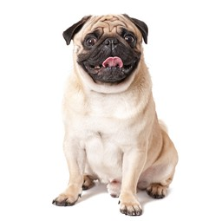
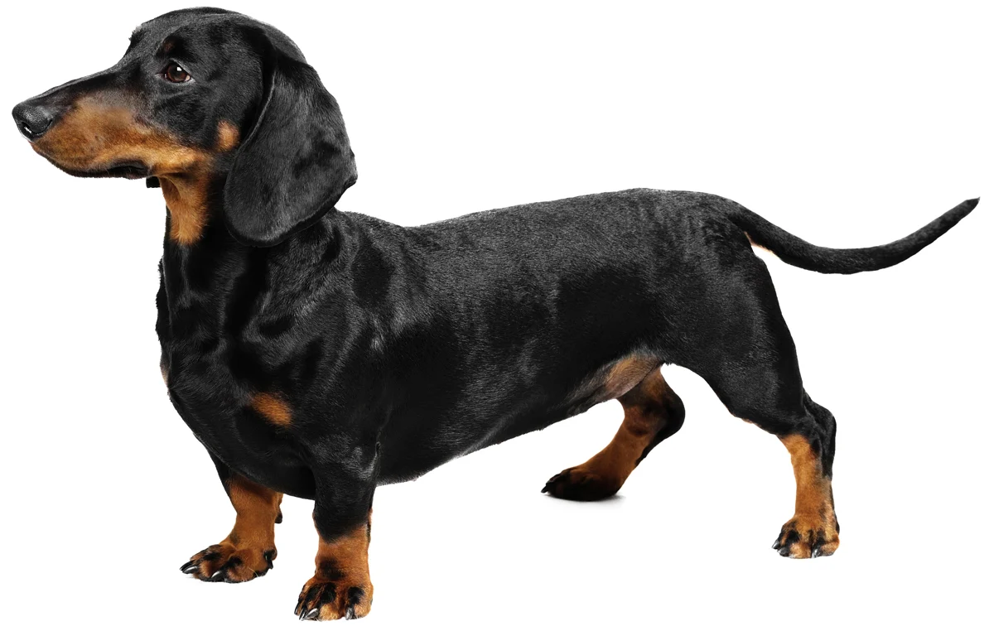
Machine learning
Dog
Cat

Slide 5
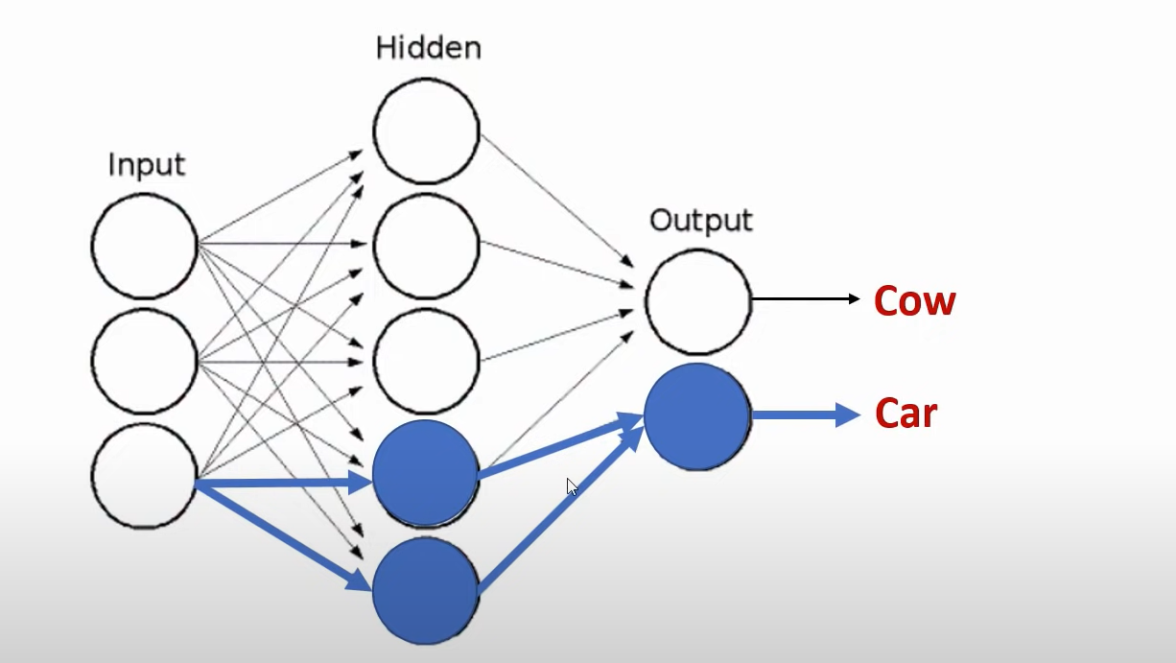

Machine learning

Slide 6
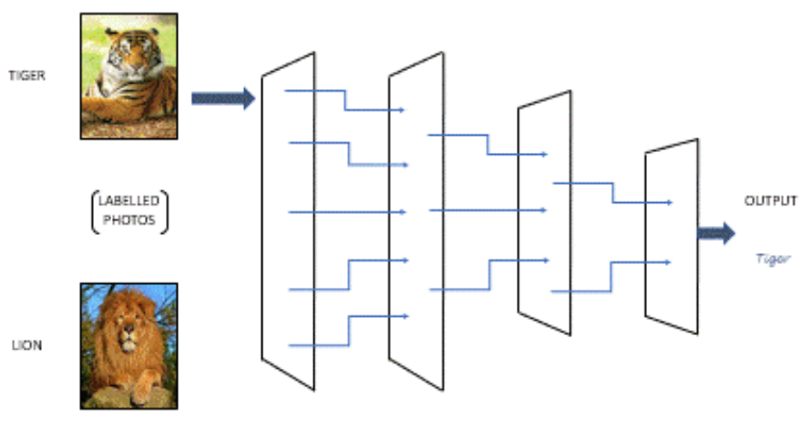
Introduction to Machine Learning
Machine Learning Process
It all starts with training the machine learning algorithm by using a training data set to create a model. When new input data is introduced to the ML algorithm, it makes a prediction. The predictions and results are evaluated for accuracy.
If the prediction is not as expected, the algorithm is re-trained again and again until the desired output is obtained. This enables the ml algorithm to learn on its own and produce an optimal answer that will gradually increase in accuracy over time.
Notes:
Machine Learning Process
Machine Learning algorithms utilize a variety of techniques to handle large amounts of complex data to make decisions. These algorithms complete the task of learning from data with specific inputs given to the machine. It’s important to understand how these algorithms and a machine learning system as a whole work, so that we can get to know how these can be used in the future.
It all starts with training the machine learning algorithm by using a training data set to create a model. When new input data is introduced to the ML algorithm, it makes a prediction. The predictions and results are evaluated for accuracy.
If the prediction is not as expected, the algorithm is re-trained again and again until the desired output is obtained. This enables the ml algorithm to learn on its own and produce an optimal answer that will gradually increase in accuracy over time.
After a desired level of accuracy is obtained, the machine learning algorithm is deployed. Let me explain to you how machine learning works with a simple example:
When you search for “Lion images” on Google Search (as seen in the image below), Google is incredibly good at bringing relevant results, but how does Google achieve this task?
Google first gets a large quantity of examples(datasets) of photos labelled “LION”.
Then the Machine learning algorithm looks for patterns of pixels and patterns of colors that will help it predict if the image is of “LION”.
At first, Google’s computers make a random guess of what patterns are good in order to identify an image of a LION.
If it makes a mistake, then a set of adjustments are made in order for the algorithm to get it right.
In the end, such a collection of patterns will be learned by a large computer system modelled after the human brain, that once trained can correctly identify and bring accurate results of LION images on Google Search.
If you were in charge of building a machine-learning algorithm to try and identify images between lions and tigers. How will you go about it?
The first step as I explained above would be to gather a large number of labelled images with “LION” for lions and “TIGER” for tigers. After this, we will train the computer to look for patterns on the images in order to identify lions and tigers respectively.
Once the machine learning model has been trained, we can give it(input) different images to see if it can correctly identify lions and tigers separately. As seen in the image above, a trained machine learning model can correctly identify such queries.

Slide 7
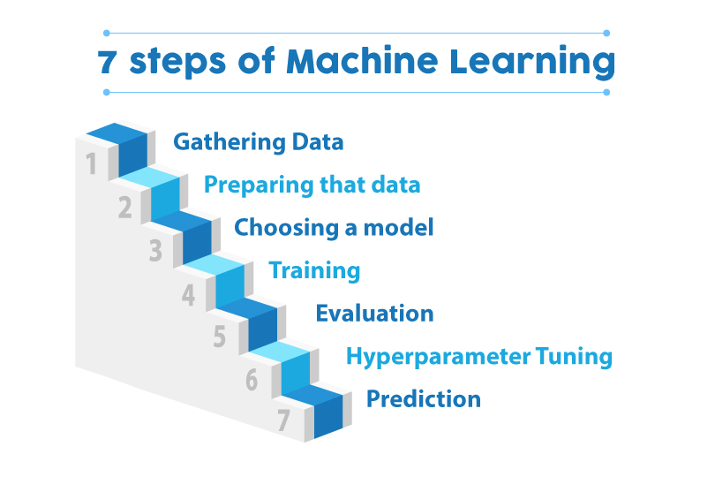

Slide 8
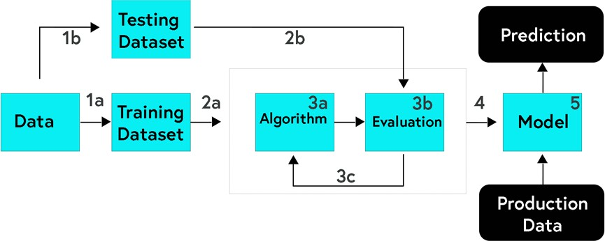
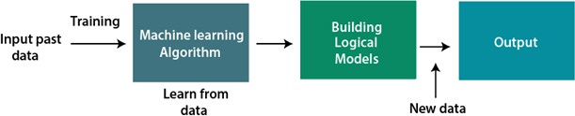
Introduction to Machine Learning
How does Machine Learning work?
The three major building blocks of a Machine Learning system are the model, the parameters, and the learner.
Model is the system which makes predictions
The parameters are the factors which are considered by the model to make predictions
The learner makes the adjustments in the parameters and the model to align the predictions with the actual results
Notes:
The three major building blocks of a Machine Learning system are the model, the parameters, and the learner.
• Model is the system which makes predictions
• The parameters are the factors which are considered by the model to make predictions
• The learner makes the adjustments in the parameters and the model to align the predictions with the actual results
Let us build on the beer and wine example from above to understand how machine learning works. A machine learning model here has to predict if a drink is a beer or wine. The parameters selected are the colour of the drink and the alcohol percentage. The first step is:

Slide 9

Introduction to Machine Learning
How does Machine Learning work?
Let’s take a sample data set of several drinks for which the colour and alcohol percentage is specified. The model can use the description to decide if a new drink is a wine or beer.
The training set
You can represent the values of the parameters, ‘colour’ and ‘alcohol percentages’ as ‘x’ and ‘y’ respectively. Then (x,y) defines the parameters of each drink in the training data. This set of data is called a training set. These values, when plotted on a graph, present a hypothesis in the form of a line, a rectangle, or a polynomial that fits best to the desired results.
To measure error
Once the model is trained on a defined training set, it needs to be checked for discrepancies and errors. We use a fresh set of data to accomplish this task. The outcome of this test would be one of these four:
True Positive: When the model predicts the condition when it is present
True Negative: When the model does not predict a condition when it is absent
False Positive: When the model predicts a condition when it is absent
False Negative: When the model does not predict a condition when it is present
The sum of FP and FN is the total error in the model.
Notes:
Learning from the training set
This involves taking a sample data set of several drinks for which the colour and alcohol percentage is specified. Now, we have to define the description of each classification, that is wine and beer, in terms of the value of parameters for each type. The model can use the description to decide if a new drink is a wine or beer.
You can represent the values of the parameters, ‘colour’ and ‘alcohol percentages’ as ‘x’ and ‘y’ respectively. Then (x,y) defines the parameters of each drink in the training data. This set of data is called a training set. These values, when plotted on a graph, present a hypothesis in the form of a line, a rectangle, or a polynomial that fits best to the desired results.
The second step is to measure error
Once the model is trained on a defined training set, it needs to be checked for discrepancies and errors. We use a fresh set of data to accomplish this task. The outcome of this test would be one of these four:
• True Positive: When the model predicts the condition when it is present
• True Negative: When the model does not predict a condition when it is absent
• False Positive: When the model predicts a condition when it is absent
• False Negative: When the model does not predict a condition when it is present
The sum of FP and FN is the total error in the model.

Slide 10
Introduction to Machine Learning
How does Machine Learning work?
Manage Noise
For the sake of simplicity, we have considered only two parameters to approach a machine learning problem here that is the colour and alcohol percentage. But, you will have to consider hundreds of parameters and a broad set of learning data to solve a machine learning problem.
The hypothesis then created will have a lot more errors because of the noise. Noise is the unwanted anomalies that disguise the underlying relationship in the data set and weakens the learning process.
Various reasons for this noise to occur are:
Large training data set
Errors in input data
Data labelling errors
Unobservable attributes that might affect the classification but are not considered in the training set due to lack of data
You can accept a certain degree of training error due to noise to keep the hypothesis as simple as possible.
Testing and Generalisation
While it is possible for an algorithm or hypothesis to fit well to a training set, it might fail when applied to another set of data outside of the training set. Therefore, It is essential to figure out if the algorithm is fit for new data. Testing it with a set of new data is the way to judge this.
Also, generalisation refers to how well the model predicts outcomes for a new set of data. When we fit a hypothesis algorithm for maximum possible simplicity, it might have less error for the training data, but might have more significant error while processing new data. We call this is underfitting. On the other hand, if the hypothesis is too complicated to accommodate the best fit to the training result, it might not generalise well. This is the case of over-fitting. In either case, the results are fed back to train the model further.
Notes:
Manage Noise
For the sake of simplicity, we have considered only two parameters to approach a machine learning problem here that is the colour and alcohol percentage. But, you will have to consider hundreds of parameters and a broad set of learning data to solve a machine learning problem.
• The hypothesis then created will have a lot more errors because of the noise. Noise is the unwanted anomalies that disguise the underlying relationship in the data set and weakens the learning process. Various reasons for this noise to occur are:
• Large training data set
• Errors in input data
• Data labelling errors
• Unobservable attributes that might affect the classification but are not considered in the training set due to lack of data
You can accept a certain degree of training error due to noise to keep the hypothesis as simple as possible.
Testing and Generalisation
While it is possible for an algorithm or hypothesis to fit well to a training set, it might fail when applied to another set of data outside of the training set. Therefore, It is essential to figure out if the algorithm is fit for new data. Testing it with a set of new data is the way to judge this. Also, generalisation refers to how well the model predicts outcomes for a new set of data.
When we fit a hypothesis algorithm for maximum possible simplicity, it might have less error for the training data, but might have more significant error while processing new data. We call this is underfitting. On the other hand, if the hypothesis is too complicated to accommodate the best fit to the training result, it might not generalise well. This is the case of over-fitting. In either case, the results are fed back to train the model further.

Slide 11
Introduction to Machine Learning
History of Machine Learning
1834: Charles Babbage, the father of the computer, conceived a device that could be programmed with punch cards. However, the machine was never built, but all modern computers rely on its logical structure.
1936: Alan Turing gave a theory that how a machine can determine and execute a set of instructions.
1940: The first manually operated computer, "ENIAC" was invented, which was the first electronic general-purpose computer. After that stored program computer such as EDSAC in 1949 and EDVAC in 1951 were invented.
1943: A human neural network was modelled with an electrical circuit. In 1950, the scientists started applying their idea to work and analysed how human neurons might work.
1950: Alan Turing published a seminal paper, "Computer Machinery and Intelligence," on the topic of artificial intelligence. In his paper, he asked, "Can machines think?“
1952: Arthur Samuel, who was the pioneer of machine learning, created a program that helped an IBM computer to play a checkers game. It performed better more it played.
1959: The term "Machine Learning" was first coined by Arthur Samuel.
1959: The first neural network was applied to a real-world problem to remove echoes over phone lines using an adaptive filter.
1985: Terry Sejnowski and Charles Rosenberg invented a neural network NETtalk, which was able to teach itself how to correctly pronounce 20,000 words in one week..
Notes:
Before some years (about 40-50 years), machine learning was science fiction, but today it is the part of our daily life. Machine learning is making our day-to-day life easy from self-driving cars to Amazon virtual assistant "Alexa". However, the idea behind machine learning is so old and has a long history. Below some milestones are given which have occurred in the history of machine learning:
The early history of Machine Learning (Pre-1940):
• 1834: In 1834, Charles Babbage, the father of the computer, conceived a device that could be programmed with punch cards. However, the machine was never built, but all modern computers rely on its logical structure.
• 1936: In 1936, Alan Turing gave a theory that how a machine can determine and execute a set of instructions.
The era of stored program computers:
• 1940: In 1940, the first manually operated computer, "ENIAC" was invented, which was the first electronic general-purpose computer. After that stored program computer such as EDSAC in 1949 and EDVAC in 1951 were invented.
• 1943: In 1943, a human neural network was modelled with an electrical circuit. In 1950, the scientists started applying their idea to work and analysed how human neurons might work.
Computer machinery and intelligence:
• 1950: In 1950, Alan Turing published a seminal paper, "Computer Machinery and Intelligence," on the topic of artificial intelligence. In his paper, he asked, "Can machines think?"
Machine intelligence in Games:
• 1952: Arthur Samuel, who was the pioneer of machine learning, created a program that helped an IBM computer to play a checkers game. It performed better more it played.
• 1959: In 1959, the term "Machine Learning" was first coined by Arthur Samuel.
The first "AI" winter:
• The duration of 1974 to 1980 was the tough time for AI and ML researchers, and this duration was called as AI winter.
• In this duration, failure of machine translation occurred, and people had reduced their interest from AI, which led to reduced funding by the government to the research.
Machine Learning from theory to reality
• 1959: In 1959, the first neural network was applied to a real-world problem to remove echoes over phone lines using an adaptive filter.
• 1985: In 1985, Terry Sejnowski and Charles Rosenberg invented a neural network NETtalk, which was able to teach itself how to correctly pronounce 20,000 words in one week.
• 1997: The IBM's Deep blue intelligent computer won the chess game against the chess expert Garry Kasparov, and it became the first computer which had beaten a human chess expert.
Machine Learning at 21st century
• 2006: In the year 2006, computer scientist Geoffrey Hinton has given a new name to neural net research as "deep learning," and nowadays, it has become one of the most trending technologies.
• 2012: In 2012, Google created a deep neural network which learned to recognize the image of humans and cats in YouTube videos.
• 2014: In 2014, the Chabot "Eugen Goostman" cleared the Turing Test. It was the first Chabot who convinced the 33% of human judges that it was not a machine.
• 2014: DeepFace was a deep neural network created by Facebook, and they claimed that it could recognize a person with the same precision as a human can do.
• 2016: AlphaGo beat the world's number second player Lee sedol at Go game. In 2017 it beat the number one player of this game Ke Jie.
• 2017: In 2017, the Alphabet's Jigsaw team built an intelligent system that was able to learn the online trolling. It used to read millions of comments of different websites to learn to stop online trolling.
Machine Learning at present:
Now machine learning has got a great advancement in its research, and it is present everywhere around us, such as self-driving cars, Amazon Alexa, Catboats, recommender system, and many more. It includes Supervised, unsupervised, and reinforcement learning with clustering, classification, decision tree, SVM algorithms, etc.
Modern machine learning models can be used for making various predictions, including weather prediction, disease prediction, stock market analysis, etc.

Slide 12
Introduction to Machine Learning
History of Machine Learning
1997: The IBM's Deep blue intelligent computer won the chess game against the chess expert Garry Kasparov, and it became the first computer which had beaten a human chess expert
2006: The computer scientist Geoffrey Hinton has given a new name to neural net research as "deep learning," and nowadays, it has become one of the most trending technologies.
2012: In 2012, Google created a deep neural network which learned to recognize the image of humans and cats in YouTube videos.
2014: In 2014, the Chatbot "Eugen Goostman" cleared the Turing Test. It was the first Chatbot who convinced the 33% of human judges that it was not a machine.
2014: DeepFace was a deep neural network created by Facebook, and they claimed that it could recognize a person with the same precision as a human can do.
2016: AlphaGo beat the world's number second player Lee sedol at Go game. In 2017 it beat the number one player of this game Ke Jie.
2017: In 2017, the Alphabet's Jigsaw team built an intelligent system that was able to learn the online trolling. It used to read millions of comments of different websites to learn to stop online trolling.
Machine Learning at present:
Now machine learning has got a great advancement in its research, and it is present everywhere around us, such as self-driving cars, Amazon Alexa, Catboats, recommender system, and many more.
Modern machine learning models can be used for making various predictions, including weather prediction, disease prediction, stock market analysis, etc
Notes:
Before some years (about 40-50 years), machine learning was science fiction, but today it is the part of our daily life. Machine learning is making our day-to-day life easy from self-driving cars to Amazon virtual assistant "Alexa". However, the idea behind machine learning is so old and has a long history. Below some milestones are given which have occurred in the history of machine learning:
The early history of Machine Learning (Pre-1940):
• 1834: In 1834, Charles Babbage, the father of the computer, conceived a device that could be programmed with punch cards. However, the machine was never built, but all modern computers rely on its logical structure.
• 1936: In 1936, Alan Turing gave a theory that how a machine can determine and execute a set of instructions.
The era of stored program computers:
• 1940: In 1940, the first manually operated computer, "ENIAC" was invented, which was the first electronic general-purpose computer. After that stored program computer such as EDSAC in 1949 and EDVAC in 1951 were invented.
• 1943: In 1943, a human neural network was modelled with an electrical circuit. In 1950, the scientists started applying their idea to work and analysed how human neurons might work.
Computer machinery and intelligence:
• 1950: In 1950, Alan Turing published a seminal paper, "Computer Machinery and Intelligence," on the topic of artificial intelligence. In his paper, he asked, "Can machines think?"
Machine intelligence in Games:
• 1952: Arthur Samuel, who was the pioneer of machine learning, created a program that helped an IBM computer to play a checkers game. It performed better more it played.
• 1959: In 1959, the term "Machine Learning" was first coined by Arthur Samuel.
The first "AI" winter:
• The duration of 1974 to 1980 was the tough time for AI and ML researchers, and this duration was called as AI winter.
• In this duration, failure of machine translation occurred, and people had reduced their interest from AI, which led to reduced funding by the government to the research.
Machine Learning from theory to reality
• 1959: In 1959, the first neural network was applied to a real-world problem to remove echoes over phone lines using an adaptive filter.
• 1985: In 1985, Terry Sejnowski and Charles Rosenberg invented a neural network NETtalk, which was able to teach itself how to correctly pronounce 20,000 words in one week.
• 1997: The IBM's Deep blue intelligent computer won the chess game against the chess expert Garry Kasparov, and it became the first computer which had beaten a human chess expert.
Machine Learning at 21st century
• 2006: In the year 2006, computer scientist Geoffrey Hinton has given a new name to neural net research as "deep learning," and nowadays, it has become one of the most trending technologies.
• 2012: In 2012, Google created a deep neural network which learned to recognize the image of humans and cats in YouTube videos.
• 2014: In 2014, the Chabot "Eugen Goostman" cleared the Turing Test. It was the first Chabot who convinced the 33% of human judges that it was not a machine.
• 2014: DeepFace was a deep neural network created by Facebook, and they claimed that it could recognize a person with the same precision as a human can do.
• 2016: AlphaGo beat the world's number second player Lee sedol at Go game. In 2017 it beat the number one player of this game Ke Jie.
• 2017: In 2017, the Alphabet's Jigsaw team built an intelligent system that was able to learn the online trolling. It used to read millions of comments of different websites to learn to stop online trolling.
Machine Learning at present:
Now machine learning has got a great advancement in its research, and it is present everywhere around us, such as self-driving cars, Amazon Alexa, Catboats, recommender system, and many more. It includes Supervised, unsupervised, and reinforcement learning with clustering, classification, decision tree, SVM algorithms, etc.
Modern machine learning models can be used for making various predictions, including weather prediction, disease prediction, stock market analysis, etc.

Slide 13
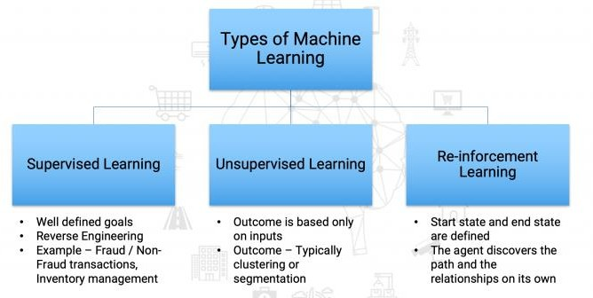
Introduction to Machine Learning
Types of Machine Learning
Notes:
In this section, we will learn about the different approaches towards machine learning and the variety of problems they can solve.
5.1.5.1 What is Supervised Learning?
The supervised learning model has a set of input variables (x), and an output variable (y). An algorithm identifies the mapping function between the input and output variables. The relationship is y = f(x).
The learning is monitored or supervised in the sense that we already know the output and the algorithm are corrected each time to optimise its results. The algorithm is trained over the data set and amended until it achieves an acceptable level of performance.
We can group the supervised learning problems as:
1. Regression problems – Used to predict future values and the model is trained with the historical data. E.g., Predicting the future price of a product.
2. Classification problems – Various labels train the algorithm to identify items within a specific category. E.g., Disease or no disease, Apple or an orange, Beer or wine.

Slide 14
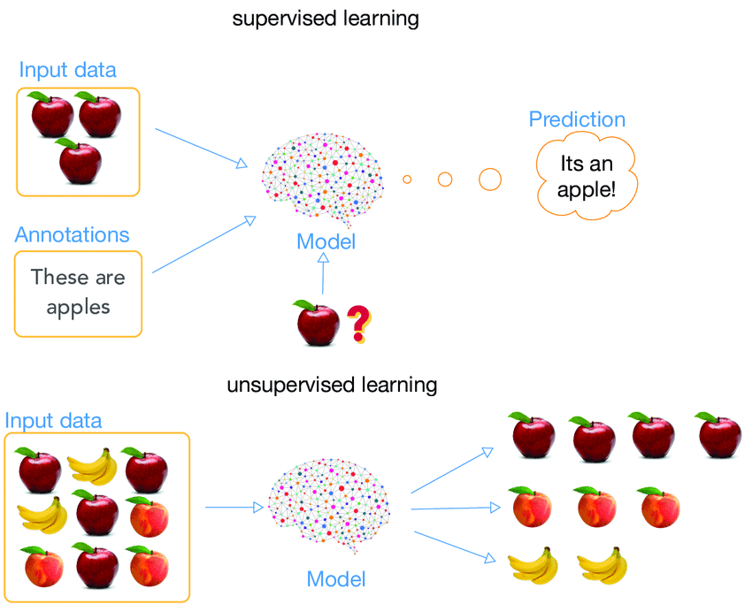
Supervised vs Unsupervised learning

Slide 15
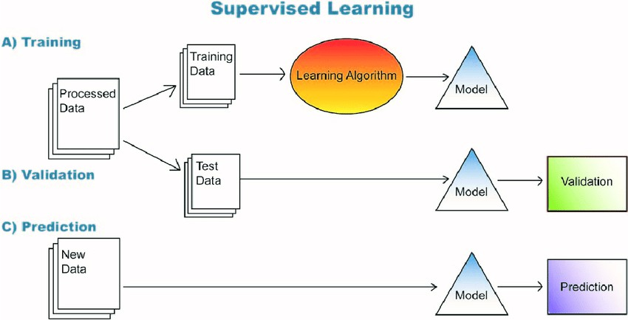
Introduction to Machine Learning
Types of Machine Learning
What is Supervised Learning?
The supervised learning model has a set of input variables (x), and an output variable (y). An algorithm identifies the mapping function between the input and output variables. The relationship is y = f(x).
The learning is monitored or supervised in the sense that we already know the output and the algorithm are corrected each time to optimise its results. The algorithm is trained over the data set and amended until it achieves an acceptable level of performance.
We can group the supervised learning problems as:
Regression problems – Used to predict future values and the model is trained with the historical data. E.g., Predicting the future price of a product.
Classification problems – Various labels train the algorithm to identify items within a specific category. E.g., Disease or no disease, Apple or an orange, Beer or wine.
Notes:
This approach is the one where the output is unknown, and we have only the input variable at hand. The algorithm learns by itself and discovers an impressive structure in the data. The goal is to decipher the underlying distribution in the data to gain more knowledge about the data.
We can group the unsupervised learning problems as:
1. Clustering: This means bundling the input variables with the same characteristics together. E.g., grouping users based on search history
2. Association: Here, we discover the rules that govern meaningful associations among the data set. E.g., People who watch ‘X’ will also watch ‘Y.’

Slide 16
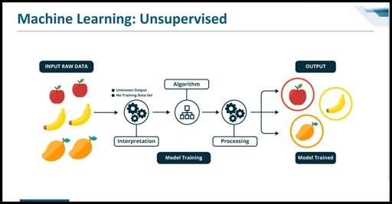
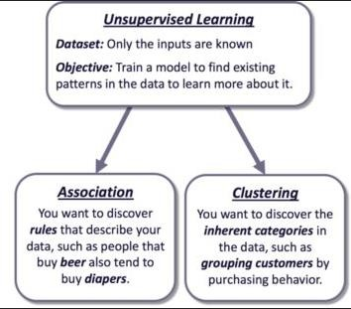
Introduction to Machine Learning
Types of Machine Learning
What is Unsupervised Learning?
This approach is the one where the output is unknown, and we have only the input variable at hand. The algorithm learns by itself and discovers an impressive structure in the data. The goal is to decipher the underlying distribution in the data to gain more knowledge about the data.
We can group the unsupervised learning problems as:
Clustering: This means bundling the input variables with the same characteristics together. E.g., grouping users based on search history
Association: Here, we discover the rules that govern meaningful associations among the data set. E.g., People who watch ‘X’ will also watch ‘Y.’

Slide 17
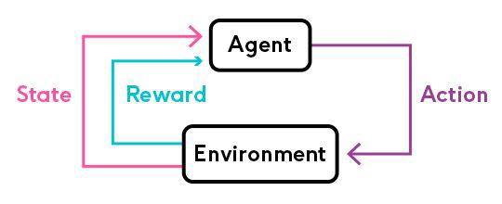
Introduction to Machine Learning
Types of Machine Learning
What is Reinforcement Learning?
In this approach, machine learning models are trained to make a series of decisions based on the rewards and feedback they receive for their actions. The machine learns to achieve a goal in complex and uncertain situations and is rewarded each time it achieves it during the learning period.
Reinforcement learning is different from supervised learning in the sense that there is no answer available, so the reinforcement agent decides the steps to perform a task. The machine learns from its own experiences when there is no training data set present.
Notes:
In this approach, machine learning models are trained to make a series of decisions based on the rewards and feedback they receive for their actions. The machine learns to achieve a goal in complex and uncertain situations and is rewarded each time it achieves it during the learning period.
Reinforcement learning is different from supervised learning in the sense that there is no answer available, so the reinforcement agent decides the steps to perform a task. The machine learns from its own experiences when there is no training data set present.
Here is a Look of some Applications of Machine Learning
Machine Learning algorithms help in building intelligent systems that can learn from their past experiences and historical data to give accurate results. Many industries are thus applying machine learning solutions to their business problems, or to create new and better products and services. Healthcare, defence, financial services, marketing, and security services, among others, use Machine Learning in their applications and processes.

Slide 18
Introduction to Machine Learning
Applications of Machine Learning
Facial recognition / Image recognition
The most common application of machine learning is Facial Recognition, and the simplest example of this application is the iPhone X. There are a lot of use-cases of facial recognition, mostly for security purposes like identifying criminals, searching for missing individuals, aid forensic investigations, etc. Intelligent marketing, diagnose diseases, track attendance in schools, are some other uses.
Automatic Speech Recognition
Abbreviated as ASR, automatic speech recognition is used to convert speech into digital text. Its applications lie in authenticating users based on their voice and performing tasks based on the human voice inputs. Speech patterns and vocabulary are fed into the system to train the model.
The most common application in our day-to-day activities is the virtual personal assistants like Siri and Alexa.
Financial Services
Machine learning has many use cases in Financial Services. Machine Learning algorithms prove to be excellent at detecting frauds by monitoring activities of each user and assess that if an attempted activity is typical of that user or not.
Financial monitoring to detect money laundering activities is also a critical security use case of machine learning.
Machine Learning also helps in making better trading decisions with the help of algorithms that can analyse thousands of data sources simultaneously. Credit scoring and underwriting are some of the other applications.
Notes:
Facial recognition / Image recognition
The most common application of machine learning is Facial Recognition, and the simplest example of this application is the iPhone X. There are a lot of use-cases of facial recognition, mostly for security purposes like identifying criminals, searching for missing individuals, aid forensic investigations, etc. Intelligent marketing, diagnose diseases, track attendance in schools, are some other uses.
Automatic Speech Recognition
Abbreviated as ASR, automatic speech recognition is used to convert speech into digital text. Its applications lie in authenticating users based on their voice and performing tasks based on the human voice inputs. Speech patterns and vocabulary are fed into the system to train the model. Presently ASR systems find a wide variety of applications in the following domains:
• Medical Assistance
• Industrial Robotics
• Forensic and Law enforcement
• Defence & Aviation
• Telecommunications Industry
• Home Automation and Security Access Control
• I.T. and Consumer Electronics
Financial Services
Machine learning has many use cases in Financial Services. Machine Learning algorithms prove to be excellent at detecting frauds by monitoring activities of each user and assess that if an attempted activity is typical of that user or not.
Financial monitoring to detect money laundering activities is also a critical security use case of machine learning.
Machine Learning also helps in making better trading decisions with the help of algorithms that can analyse thousands of data sources simultaneously. Credit scoring and underwriting are some of the other applications.
The most common application in our day-to-day activities is the virtual personal assistants like Siri and Alexa.
Marketing and Sales
Machine Learning is improving lead scoring algorithms by including various parameters such as website visits, emails opened, downloads, and clicks to score each lead. It also helps businesses to improve their dynamic pricing models by using regression techniques to make predictions.
Sentiment Analysis is another essential application to gauge consumer response to a specific product or a marketing initiative. Machine Learning for Computer Vision helps brands identify their products in images and videos online. These brands also use computer vision to measure the mentions that miss out on any relevant text. Chatbots are also becoming more responsive and intelligent with the help of machine learning.
Healthcare
A vital application of Machine Learning is in the diagnosis of diseases and ailments, which are otherwise difficult to diagnose. Radiotherapy is also becoming better with Machine Learning taking over.
Early-stage drug discovery is another crucial application which involves technologies such as precision medicine and next-generation sequencing. Clinical trials cost a lot of time and money to complete and deliver results. Applying Machine Learning based predictive analytics could improve on these factors and give better results.
Machine Learning technologies are also critical to make outbreak predictions. Scientists around the world are using these technologies to predict epidemic outbreaks.
Recommendation Systems
Many businesses today use recommendation systems to effectively communicate with the users on their site. It can recommend relevant products, movies, web-series, songs, and much more. Most prominent use-cases of recommendation systems are e-commerce sites like Amazon, Flipkart, and many others, along with Spotify, Netflix, and other web-streaming channels.

Slide 19
Introduction to Machine Learning
Applications of Machine Learning
Marketing and Sales
Machine Learning is improving lead scoring algorithms by including various parameters such as website visits, emails opened, downloads, and clicks to score each lead. It also helps businesses to improve their dynamic pricing models by using regression techniques to make predictions.
Healthcare
A vital application of Machine Learning is in the diagnosis of diseases and ailments, which are otherwise difficult to diagnose. Radiotherapy is also becoming better with Machine Learning taking over.
Early-stage drug discovery is another crucial application which involves technologies such as precision medicine and next-generation sequencing. Clinical trials cost a lot of time and money to complete and deliver results. Applying Machine Learning based predictive analytics could improve on these factors and give better results.
Machine Learning technologies are also critical to make outbreak predictions. Scientists around the world are using these technologies to predict epidemic outbreaks.
Recommendation Systems
Many businesses today use recommendation systems to effectively communicate with the users on their site. It can recommend relevant products, movies, web-series, songs, and much more. Most prominent use-cases of recommendation systems are e-commerce sites like Amazon, Flipkart, and many others, along with Spotify, Netflix, and other web-streaming channels

Slide 20
SUPERVISED LEARNING ALGORITHM

Slide 21
Supervised Learning Algorithm
What is Supervised Learning?
Supervised learning is a process of providing input data as well as correct output data to the machine learning model. The aim of a supervised learning algorithm is to find a mapping function to map the input variable(x) with the output variable(y).
In the real-world, supervised learning can be used for Risk Assessment, Image classification, Fraud Detection, spam filtering, etc.
Notes:
Supervised learning is the types of machine learning in which machines are trained using well "labelled" training data, and on basis of that data, machines predict the output. The labelled data means some input data is already tagged with the correct output.
In supervised learning, the training data provided to the machines work as the supervisor that teaches the machines to predict the output correctly. It applies the same concept as a student learns in the supervision of the teacher.
Supervised learning is a process of providing input data as well as correct output data to the machine learning model. The aim of a supervised learning algorithm is to find a mapping function to map the input variable(x) with the output variable(y).
In the real-world, supervised learning can be used for Risk Assessment, Image classification, Fraud Detection, spam filtering, etc.

Slide 22
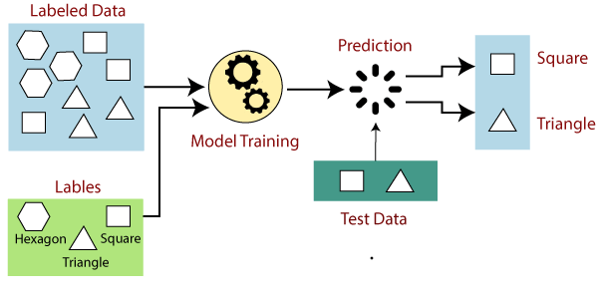
Supervised Learning Algorithm
How Supervised Learning Works?
In supervised learning, models are trained using labelled dataset, where the model learns about each type of data. Once the training process is completed, the model is tested based on test data (a subset of the training set), and then it predicts the output.
The working of Supervised learning can be easily understood by the below example and diagram:
Notes:
How Supervised Learning Works?
In supervised learning, models are trained using labelled dataset, where the model learns about each type of data. Once the training process is completed, the model is tested based on test data (a subset of the training set), and then it predicts the output.
The working of Supervised learning can be easily understood by the below example and diagram:
Suppose we have a dataset of different types of shapes which includes square, rectangle, triangle, and Polygon. Now the first step is that we need to train the model for each shape.
• If the given shape has four sides, and all the sides are equal, then it will be labelled as a Square.
• If the given shape has three sides, then it will be labelled as a triangle.
• If the given shape has six equal sides, then it will be labelled as hexagon.
Now, after training, we test our model using the test set, and the task of the model is to identify the shape.
The machine is already trained on all types of shapes, and when it finds a new shape, it classifies the shape on the bases of a number of sides and predicts the output.

Slide 23
Supervised Learning Algorithm
Steps Involved in Supervised Learning
First Determine the type of training dataset
Collect/Gather the labelled training data.
Split the training dataset into training dataset, test dataset, and validation dataset.
Determine the input features of the training dataset, which should have enough knowledge so that the model can accurately predict the output.
Determine the suitable algorithm for the model, such as support vector machine, decision tree, etc.
Execute the algorithm on the training dataset. Sometimes we need validation sets as the control parameters, which are the subset of training datasets.
Evaluate the accuracy of the model by providing the test set. If the model predicts the correct output, which means our model is accurate

Slide 24
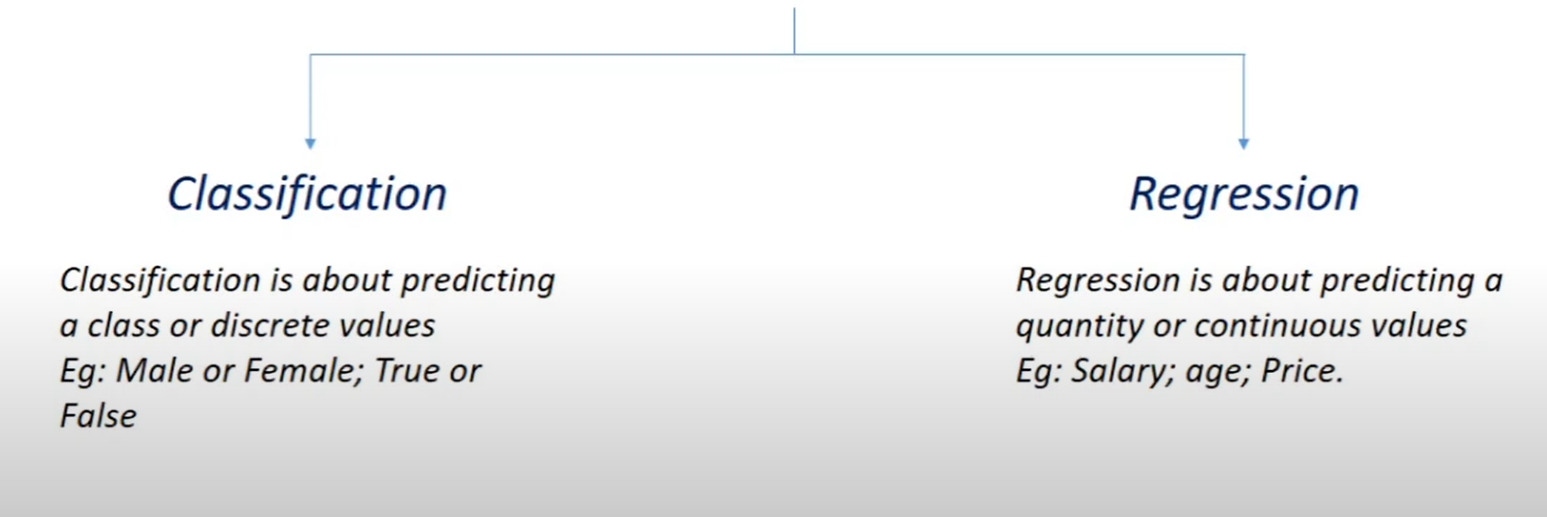
Supervised Learning Algorithm
SUPERVISED LEARNING

Slide 25
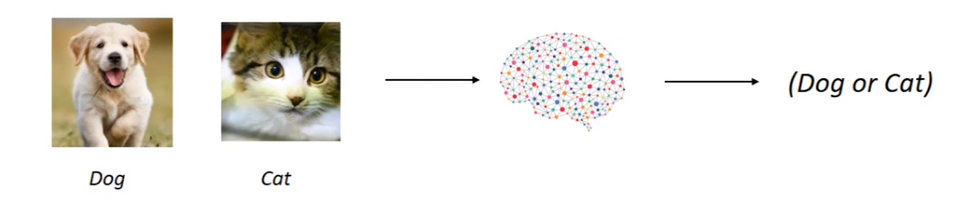
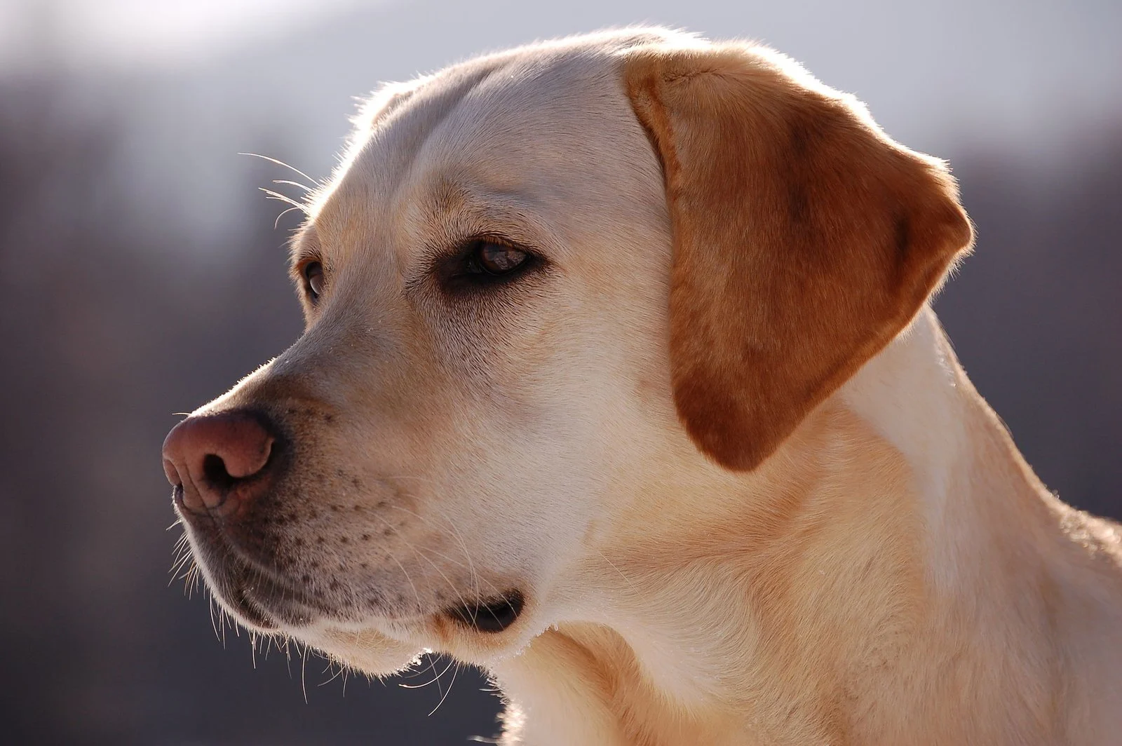
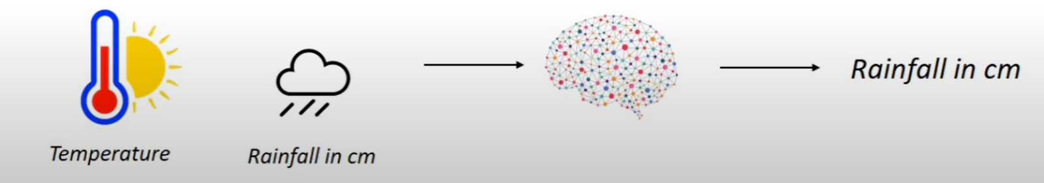
CLASSIFICATION VS REGRESSION
CLASSIFICATION
REGRESSION

Slide 26
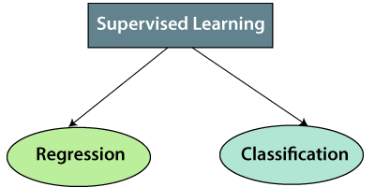
Supervised Learning Algorithm
Types of supervised Machine learning Algorithms
Regression algorithms are used if there is a relationship between the input variable and the output variable. It is used for the prediction of continuous variables, such as Weather forecasting, Market Trends, etc.
Below are some popular Regression algorithms which come under supervised learning:
Linear Regression
Logistic Regression
Polynomial Regression
Support Vector Regression
Decision Tree Regression
Random Forest Regression
Ridge Regression
Lasso Regression
Classification algorithms are used when the output variable is categorical, which means there are two classes such as Yes-No, Male-Female, True-false, etc.
Random Forest
Decision Trees
Logistic Regression
Support vector Machines
K-Nearest Neighbors
Naïve Bayes Theorem

Slide 27
Supervised Learning Algorithm
Advantages & Disadvantages of Supervised learning
Advantages
With the help of supervised learning, the model can predict the output on the basis of prior experiences.
In supervised learning, we can have an exact idea about the classes of objects.
Supervised learning model helps us to solve various real-world problems such as fraud detection, spam filtering, etc.
Disadvantages
Supervised learning models are not suitable for handling the complex tasks.
Supervised learning cannot predict the correct output if the test data is different from the training dataset.
Training required lots of computation times

Slide 28
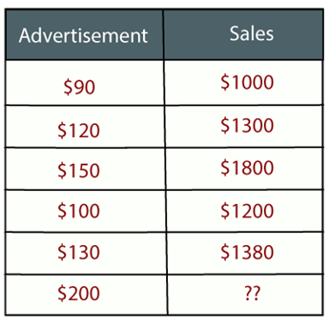
Supervised Learning Algorithm
Regression Analysis in Machine learning
Regression analysis is a statistical method to model the relationship between a dependent (target) and independent (predictor) variables with one or more independent variables. More specifically, Regression analysis helps us to understand how the value of the dependent variable is changing corresponding to an independent variable when other independent variables are held fixed. It predicts continuous/real values such as temperature, age, salary, price, etc
Example: Suppose there is a marketing company A, who does various advertisement every year and get sales on that. The list shows the advertisement made by the company in the last 5 years and the corresponding sales
Now, the company wants to do the advertisement of $200 in the year 2019 and wants to know the prediction about the sales for this year. So to solve such type of prediction problems in machine learning, we need regression analysis

Slide 29
Supervised Learning Algorithm
Terminologies Related to the Regression Analysis
Dependent Variable: The main factor in Regression analysis which we want to predict or understand is called the dependent variable. It is also called target variable.
Independent Variable: The factors which affect the dependent variables, or which are used to predict the values of the dependent variables are called independent variable, also called as a predictor.
Outliers: Outlier is an observation which contains either very low value or very high value in comparison to other observed values. An outlier may hamper the result, so it should be avoided.
Multicollinearity: If the independent variables are highly correlated with each other than other variables, then such condition is called Multicollinearity. It should not be present in the dataset, because it creates problem while ranking the most affecting variable.
Underfitting and Overfitting: If our algorithm works well with the training dataset but not well with test dataset, then such problem is called Overfitting. And if our algorithm does not perform well even with training dataset, then such problem is called underfitting

Slide 30
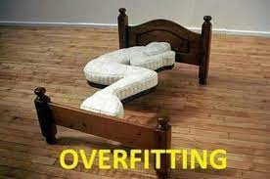

Underfitting and Overfitting
The above picture clearly indicates overfitting vs underfitting and optimal.
When a model fits more data than it needs , it starts catching the noisy data and inaccurate values in the data. As a result , the efficiency and accuracy of the model decrease.

Slide 31
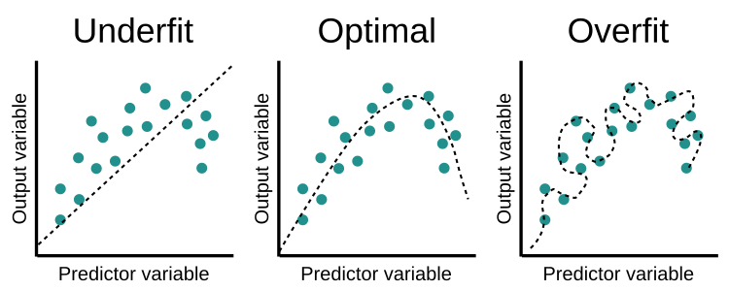
Diagrams Representing different Fits in ML

Slide 32
Supervised Learning Algorithm
Why do we use Regression Analysis?
As mentioned above, Regression analysis helps in the prediction of a continuous variable. There are various scenarios in the real world where we need some future predictions such as weather condition, sales prediction, marketing trends, etc., for such case we need some technology which can make predictions more accurately. So for such case we need Regression analysis which is a statistical method and used in machine learning and data science. Below are some other reasons for using Regression analysis:
Regression estimates the relationship between the target and the independent variable.
It is used to find the trends in data.
It helps to predict real/continuous values.
By performing the regression, we can confidently determine the most important factor, the least important factor, and how each factor is affecting the other factors

Slide 33
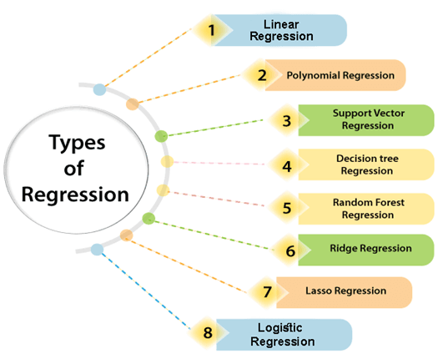
Supervised Learning Algorithm
Types of Regression
Notes:
Types of Regression
There are various types of regressions which are used in data science and machine learning. Each type has its own importance on different scenarios, but at the core, all the regression methods analyse the effect of the independent variable on dependent variables. Here we are discussing some important types of regression which are given below:
• Linear Regression
• Logistic Regression
• Polynomial Regression
• Support Vector Regression
• Decision Tree Regression
• Random Forest Regression
• Ridge Regression
• Lasso Regression

Slide 34
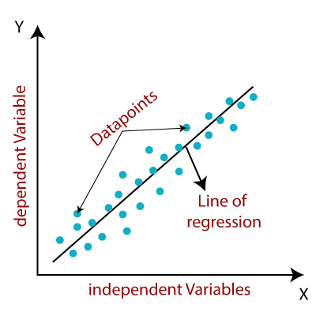

Supervised Learning Algorithm
Linear Regression in Machine Learning
Linear regression is one of the easiest and most popular Machine Learning algorithms. It is a statistical method that is used for predictive analysis. Linear regression makes predictions for continuous/real or numeric variables such as sales, salary, age, product price, etc.
Linear regression algorithm shows a linear relationship between a dependent (y) and one or more independent (y) variables, hence called as linear regression.
Mathematically, we can represent a linear regression as:
Here,
Y= Dependent Variable (Target Variable)
X= Independent Variable (predictor Variable)
a0= intercept of the line (Gives an additional degree of freedom)
a1 = Linear regression coefficient (scale factor to each input value).
ε = random error
The values for x and y variables are training datasets for Linear Regression model representation.

Slide 35
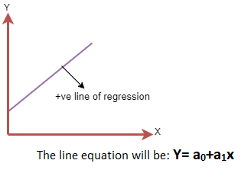
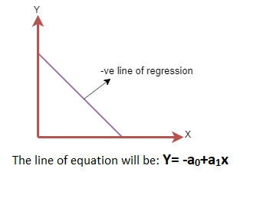
Supervised Learning Algorithm
Linear Regression in Machine Learning
Positive Linear Relationship:
If the dependent variable increases on the Y-axis and independent variable increases on X-axis, then such a relationship is termed as a Positive linear relationship.
Negative Linear Relationship:
If the dependent variable decreases on the Y-axis and independent variable increases on the X-axis, then such a relationship is called a negative linear relationship.

Slide 36
Supervised Learning Algorithm
Types of Linear Regression
Simple Linear Regression:
If a single independent variable is used to predict the value of a numerical dependent variable, then such a Linear Regression algorithm is called Simple Linear Regression.
Multiple Linear Regression:
If more than one independent variable is used to predict the value of a numerical dependent variable, then such a Linear Regression algorithm is called Multiple Linear Regression

Slide 37
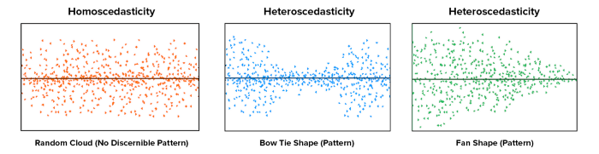
Supervised Learning Algorithm
Assumptions of Linear Regression
Linear regression assumes the linear relationship between the dependent and independent variables.
Multicollinearity means high correlation between the independent variables. Due to multicollinearity, it may be difficult to find the true relationship between the predictors and target variables. Or we can say, it is difficult to determine which predictor variable is affecting the target variable and which is not. So, the model assumes either little or no multicollinearity between the features or independent variables.
Homoscedasticity is a situation when the error term is the same for all the values of independent variables. With homoscedasticity, there should be no clear pattern distribution of data in the scatter plot.
Linear regression assumes that the error term should follow the normal distribution pattern.It can be checked using the q-q plot. If the plot shows a straight line without any deviation, which means the error is normally distributed.
The linear regression model assumes no autocorrelation in error terms. If there will be any correlation in the error term, then it will drastically reduce the accuracy of the model. Autocorrelation usually occurs if there is a dependency between residual errors
In statistics, a Q–Q plot is a probability plot, which is a graphical method for comparing two probability distributions by plotting their quantiles against each other

Slide 38
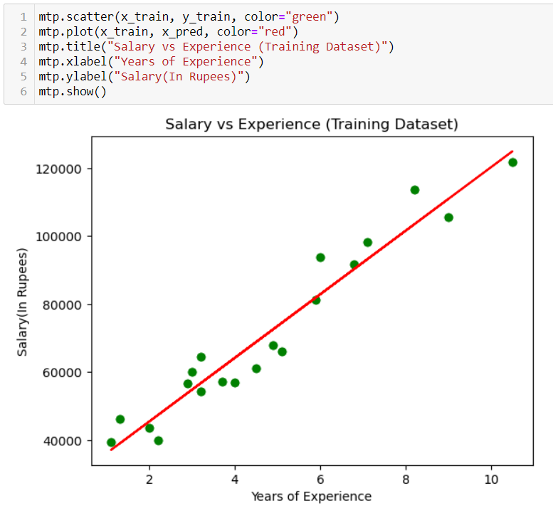
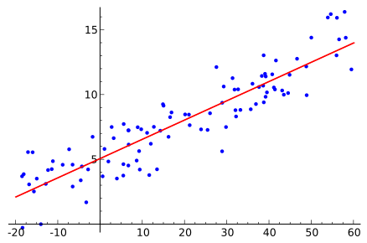
Supervised Learning Algorithm
Simple Linear Regression Model

Slide 39
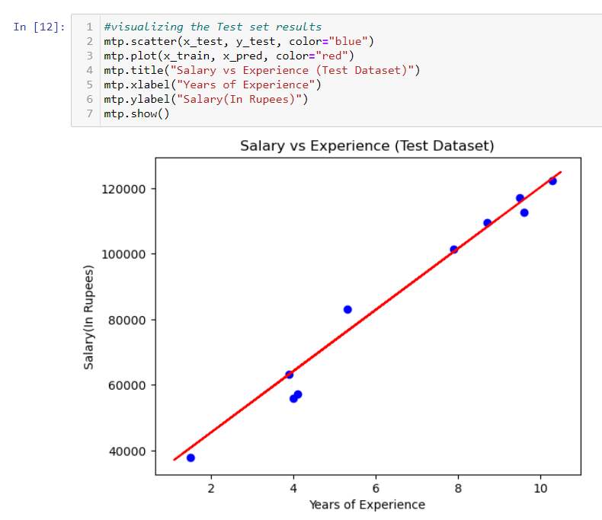
Supervised Learning Algorithm
Simple Linear Regression Model

Slide 40
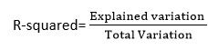
Supervised Learning Algorithm
Model Performance
The Goodness of fit determines how the line of regression fits the set of observations. The process of finding the best model out of various models is called optimization. It can be achieved by below method:
R-squared method:
R-squared is a statistical method that determines the goodness of fit.
It measures the strength of the relationship between the dependent and independent variables on a scale of 0-100%.
The high value of R-square determines the less difference between the predicted values and actual values and hence represents a good model.
It is also called a coefficient of determination, or coefficient of multiple determination for multiple regression.
It can be calculated from the below formula:
Notes:
Model Performance:
The Goodness of fit determines how the line of regression fits the set of observations. The process of finding the best model out of various models is called optimization. It can be achieved by below method:
1. R-squared method:
• R-squared is a statistical method that determines the goodness of fit.
• It measures the strength of the relationship between the dependent and independent variables on a scale of 0-100%.
• The high value of R-square determines the less difference between the predicted values and actual values and hence represents a good model.
• It is also called a coefficient of determination, or coefficient of multiple determination for multiple regression.
• It can be calculated from the below formula:

Slide 41
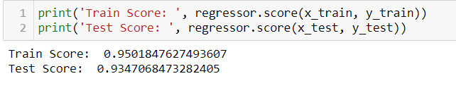
Supervised Learning Algorithm
Multiple Linear Regression Model
Some key points about MLR:
For MLR, the dependent or target variable(Y) must be the continuous/real, but the predictor or independent variable may be of continuous or categorical form.
Each feature variable must model the linear relationship with the dependent variable.
MLR tries to fit a regression line through a multidimensional space of data-points.
There are mainly two applications of Multiple Linear Regression:
• Effectiveness of Independent variable on prediction
• Predicting the impact of changes

Slide 42
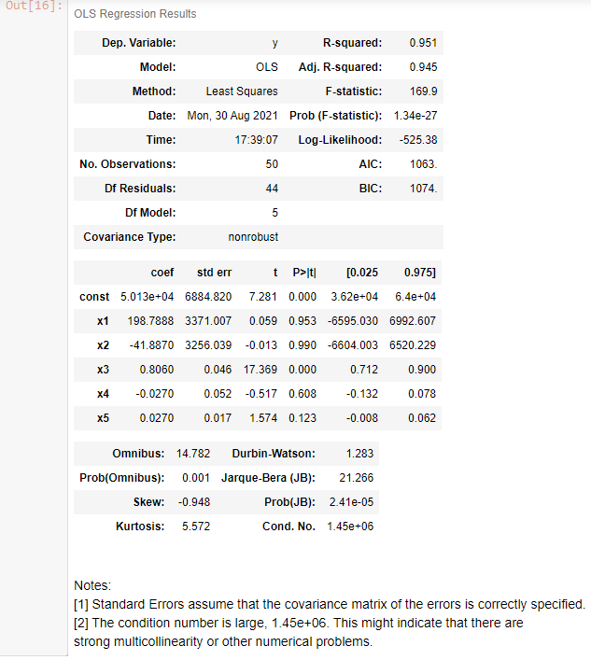
Supervised Learning Algorithm
Backward Elimination
Backward elimination is a feature selection technique while building a machine learning model. It is used to remove those features that do not have a significant effect on the dependent variable or prediction of output

Slide 43
Supervised Learning Algorithm
Methods to build model
All-in
Backward Elimination
Forward Selection
Bidirectional Elimination
Score Comparison

Slide 44

Supervised Learning Algorithm
Polynomial Regression
Polynomial Regression is a regression algorithm that models the relationship between a dependent(y) and independent variable(x) as nth degree polynomial. The Polynomial Regression equation is given below:
y= b0+b1x1+ b2x12+ b2x13+...... bnx1n
It is also called the special case of Multiple Linear Regression in ML. Because we add some polynomial terms to the Multiple Linear regression equation to convert it into Polynomial Regression.
It is a linear model with some modification in order to increase the accuracy.
The dataset used in Polynomial regression for training is of non-linear nature.
It makes use of a linear regression model to fit the complicated and non-linear functions and datasets.
Hence, "In Polynomial regression, the original features are converted into Polynomial features of required degree (2,3,..,n) and then modelled using a linear model

Slide 45
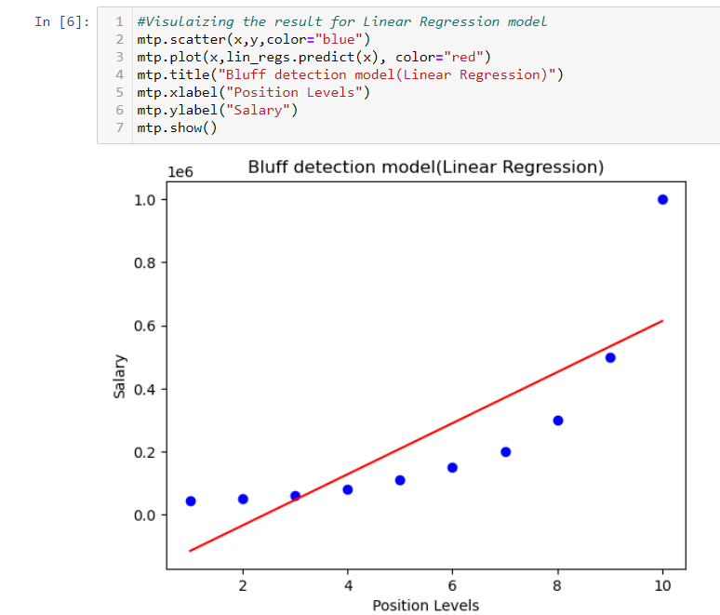
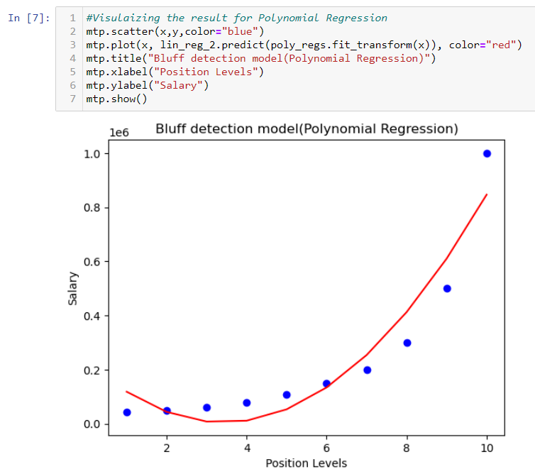
Supervised Learning Algorithm
Polynomial Regression

Slide 46
Supervised Learning Algorithm
Regression Evaluation Metrics
Here are three common evaluation metrics for regression problems:
Mean Absolute Error (MAE) is the mean of the absolute value of the errors: 1n∑i=1n|yi−y^i|
Mean Squared Error (MSE) is the mean of the squared errors: 1n∑i=1n(yi−y^i)2
Root Mean Squared Error (RMSE) is the square root of the mean of the squared errors: 1n∑i=1n(yi−y^i)2−−−−−−−−−−−−√
Comparing these metrics:
MAE is the easiest to understand, because it's the average error.
MSE is more popular than MAE, because MSE "punishes" larger errors, which tends to be useful in the real world.
RMSE is even more popular than MSE, because RMSE is interpretable in the "y" units

Slide 47
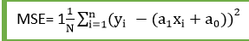
Supervised Learning Algorithm
Finding the best fit line
When working with linear regression, our main goal is to find the best fit line that means the error between predicted values and actual values should be minimized. The best fit line will have the least error.
The different values for weights or the coefficient of lines (a0, a1) gives a different line of regression, so we need to calculate the best values for a0 and a1 to find the best fit line, so to calculate this we use cost function.
Cost function-
The different values for weights or coefficient of lines (a0, a1) gives the different line of regression, and the cost function is used to estimate the values of the coefficient for the best fit line.
Cost function optimizes the regression coefficients or weights. It measures how a linear regression model is performing.
We can use the cost function to find the accuracy of the mapping function, which maps the input variable to the output variable. This mapping function is also known as Hypothesis function.
For Linear Regression, we use the Mean Squared Error (MSE) cost function, which is the average of squared error occurred between the predicted values and actual values. It can be written as:
Where,
N=Total number of observations
Yi = Actual value
(a1xi+a0)= Predicted value.
Residuals: The distance between the actual value and predicted values is called residual. If the observed points are far from the regression line, then the residual will be high, and so cost function will high. If the scatter points are close to the regression line, then the residual will be small and hence the cost function.

Slide 48
Supervised Learning Algorithm
Gradient Descent
Gradient descent is used to minimize the MSE by calculating the gradient of the cost function.
A regression model uses gradient descent to update the coefficients of the line by reducing the cost function.
It is done by a random selection of values of coefficient and then iteratively update the values to reach the minimum cost function
An Algorithm to minimize a function by optimizing its parameters.
(New value = old value – step size)

Slide 49
Supervised Learning Algorithm
Data Pre-Processing with Sklearn
Standard Scaler helps to get standardized distribution, with a zero mean and standard deviation of one (unit variance). It standardizes features by subtracting the mean value from the feature and then dividing the result by feature standard deviation
z = (x-u) / s
z is scaled data.
x is to be scaled data.
u is the mean of the training samples
s is the standard deviation of the training samples.

Slide 50
Supervised Learning Algorithm
Random Sample Consensus - RANSAC
Random sample consensus (RANSAC) is an iterative method to estimate parameters of a mathematical model from a set of observed data that contains outliers, when outliers are to be accorded no influence on the values of the estimates. Therefore, it also can be interpreted as an outlier detection method.
A basic assumption is that the data consists of "inliers", i.e., data whose distribution can be explained by some set of model parameters, though may be subject to noise, and "outliers" which are data that do not fit the model. The outliers can come, for example, from extreme values of the noise or from erroneous measurements or incorrect hypotheses about the interpretation of data. RANSAC also assumes that, given a (usually small) set of inliers, there exists a procedure which can estimate the parameters of a model that optimally explains or fits this data.

Slide 51
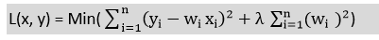
Supervised Learning Algorithm
Ridge Regression:
Ridge regression is one of the most robust versions of linear regression in which a small amount of bias is introduced so that we can get better long-term predictions.
The amount of bias added to the model is known as Ridge Regression penalty. We can compute this penalty term by multiplying with the lambda to the squared weight of each individual features.
The equation for ridge regression will be: Ridge R = Loss + α||W|| ^2 (PENALTY , Where
||W|| ^2= W1^2+W2^2+W3^2+…….Wn
A general linear or polynomial regression will fail if there is high collinearity between the independent variables, so to solve such problems, Ridge regression can be used.
Ridge regression is regularization technique, which is used to reduce the complexity of the model. It is also called as L2 regularization.
It helps to solve the problems if we have more parameters than samples

Slide 52
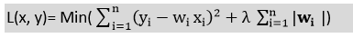
Lasso Regression
Lasso regression is another regularization technique to reduce the complexity of the model.
It is like the Ridge Regression except that penalty term contains only the absolute weights instead of a square of weights.
Since it takes absolute values, hence, it can shrink the slope to 0, whereas Ridge Regression can only shrink it near to 0.
It is also called as L1 regularization. The equation for Lasso regression will be:

Slide 53
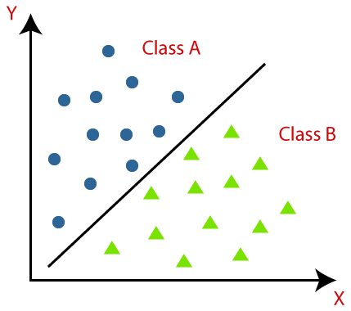
Supervised Learning Algorithm
Classification Algorithm
The Classification algorithm is a Supervised Learning technique that is used to identify the category of new observations based on training data. In Classification, a program learns from the given dataset or observations and then classifies new observation into a few classes or groups. Such as, Yes or No, 0 or 1, Spam or Not Spam, cat or dog, etc. Classes can be called as targets/labels or categories

Slide 54
Supervised Learning Algorithm
Classification Algorithm
Binary Classifier: If the classification problem has only two possible outcomes, then it is called as Binary Classifier. Examples: YES or NO, MALE or FEMALE, SPAM or NOT SPAM, CAT or DOG, etc.
Multi-class Classifier: If a classification problem has more than two outcomes, then it is called as Multi-class Classifier. Example: Classifications of types of crops, Classification of types of music

Slide 55
Supervised Learning Algorithm
Classification Algorithm
Lazy Learners: Lazy Learner firstly stores the training dataset and wait until it receives the test dataset. In Lazy learner case, classification is done on the basis of the most related data stored in the training dataset. It takes less time in training but more time for predictions. Example: K-NN algorithm, Case-based reasoning
Eager Learners: Eager Learners develop a classification model based on a training dataset before receiving a test dataset. Opposite to Lazy learners, Eager Learner takes more time in learning, and less time in prediction. Example: Decision Trees, Naïve Bayes, ANN

Slide 56

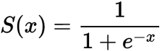
Supervised Learning Algorithm
Logistic Regression in Machine Learning
Logistic regression predicts the output of a categorical dependent variable. Therefore, the outcome must be a categorical or discrete value. It can be either Yes or No, 0 or 1, true or False, etc. but instead of giving the exact value as 0 and 1, it gives the probabilistic values which lie between 0 and 1.
e (Euler's constant ) = 2.71828
Assumptions for Logistic Regression
The dependent variable must be categorical in nature.
The independent variable should not have multi-collinearity

Slide 57
Supervised Learning Algorithm
Type of Logistic Regression
Based on the categories, Logistic Regression can be classified into three types:
Binomial: In binomial Logistic regression, there can be only two possible types of the dependent variables, such as 0 or 1, Pass or Fail, etc.
Multinomial: In multinomial Logistic regression, there can be 3 or more possible unordered types of the dependent variable, such as "cat", "dogs", or "sheep"
Ordinal: In ordinal Logistic regression, there can be 3 or more possible ordered types of dependent variables, such as "low", "Medium", or "High"

Slide 58
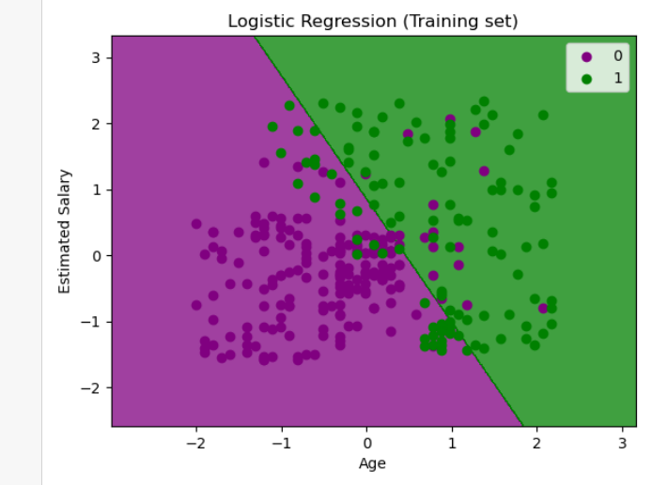
Supervised Learning Algorithm
Logistic Regression in Python

Slide 59
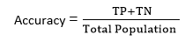
Supervised Learning Algorithm
Evaluating a Classification model
Confusion Matrix:
The confusion matrix provides us a matrix/table as output and describes the performance of the model.
It is also known as the error matrix.
The matrix consists of predictions result in a summarized form, which has a total number of correct predictions and incorrect predictions.
The matrix looks like as below table:
 | Actual Positive | Actual Negative
Predicted Positive | True Positive | False Positive
Predicted Negative | False Negative | True Negative

Slide 60
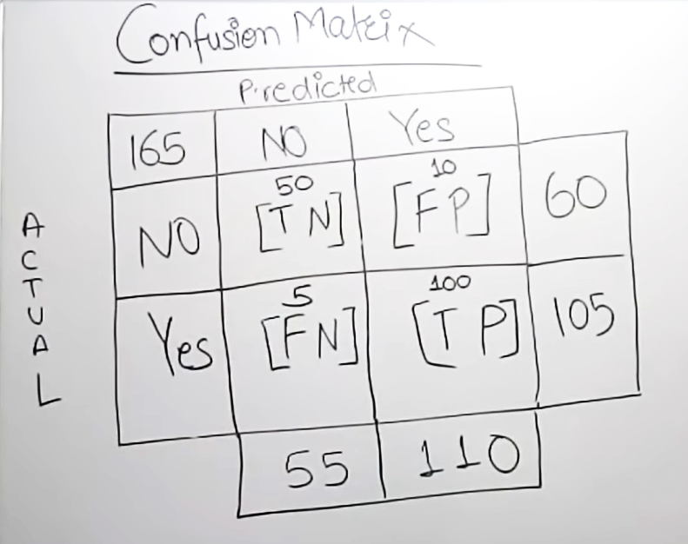
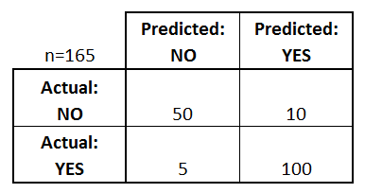
Confusion matrix

Slide 61
Confusion matrix formulas
Error rate = 1- Accuracy
OR
FP + FN
TOTAL
Precision = TP / Predicted Yes
TPR/SENSITIVITY/Recall = TP / Actual Yes
Specificity (True Negative Rate) =TN / TN +FP
False positive Rate(FPR) = FP /FP +TN
FPR =1- SPECIFICITY

Slide 62
Supervised Learning Algorithm
Evaluating a Classification model
AUC-ROC curve:
ROC curve stands for Receiver Operating Characteristics Curve and AUC stands for Area Under the Curve.
It is a graph that shows the performance of the classification model at different thresholds.
To visualize the performance of the multi-class classification model, we use the AUC-ROC Curve.
The ROC curve is plotted with TPR and FPR, where TPR (True Positive Rate) on Y-axis and FPR(False Positive Rate) on X-axis

Slide 63
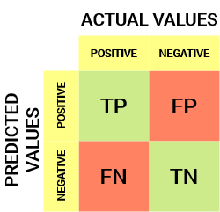
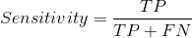
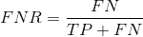
Supervised Learning Algorithm
Evaluating a Classification model
AUC-ROC curve
Sensitivity / True Positive Rate / Recall
Sensitivity tells us what proportion of the positive class got correctly classified.
A simple example would be to determine what proportion of the actual sick people were correctly detected by the model.
False Negative Rate
False Negative Rate (FNR) tells us what proportion of the positive class got incorrectly classified by the classifier.
A higher TPR and a lower FNR is desirable since we want to correctly classify the positive class.

Slide 64
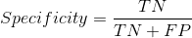

Supervised Learning Algorithm
Evaluating a Classification model
AUC-ROC curve
Specificity / True Negative Rate
Specificity tells us what proportion of the negative class got correctly classified.
Taking the same example as in Sensitivity, Specificity would mean determining the proportion of healthy people who were correctly identified by the model
False Positive Rate
FPR tells us what proportion of the negative class got incorrectly classified by the classifier.
A higher TNR and a lower FPR is desirable since we want to correctly classify the negative class.

Slide 65

Evaluating a Classification model
Probability of Predictions

Slide 66

Supervised Learning Algorithm
Evaluating a Classification model
AUC-ROC curve
When AUC = 1, then the classifier is able to perfectly distinguish between all the Positive and the Negative class points correctly. If, however, the AUC had been 0, then the classifier would be predicting all Negatives as Positives, and all Positives as Negatives.

Slide 67

Supervised Learning Algorithm
Evaluating a Classification model
AUC-ROC curve
When 0.5<AUC<1, there is a high chance that the classifier will be able to distinguish the positive class values from the negative class values. This is so because the classifier can detect more numbers of True positives and True negatives than False negatives and False positives.

Slide 68

Supervised Learning Algorithm
Evaluating a Classification model
AUC-ROC curve
When AUC=0.5, then the classifier is not able to distinguish between Positive and Negative class points. Meaning either the classifier is predicting random class or constant class for all the data points

Slide 69


Supervised Learning Algorithm
Evaluating a Classification model
AUC-ROC curve
Point A is where the Sensitivity is the highest and Specificity the lowest. This means all the Positive class points are classified correctly and all the Negative class points are classified incorrectly

Slide 70

Supervised Learning Algorithm
Evaluating a Classification model
AUC-ROC curve
Although Point B has the same Sensitivity as Point A, it has a higher Specificity. Meaning the number of incorrectly Negative class points is lower compared to the previous threshold. This indicates that this threshold is better than the previous one

Slide 71

Supervised Learning Algorithm
Evaluating a Classification model
AUC-ROC curve
Between points C and D, the Sensitivity at point C is higher than point D for the same Specificity. This means, for the same number of incorrectly classified Negative class points, the classifier predicted a higher number of Positive class points. Therefore, the threshold at point C is better than point D

Slide 72

Supervised Learning Algorithm
Evaluating a Classification model
AUC-ROC curve
Point E is where the Sensitivity becomes highest. Meaning there are no False Positives classified by the model. The model can correctly classify all the Negative class points! We would choose this point if our problem was to give perfect song recommendations to our users

Slide 73

Supervised Learning Algorithm
Evaluating a Classification model
AUC-ROC curve in Python

Slide 74

Supervised Learning Algorithm
Decision Tree in Machine Learning
Root Node: Root node is from where the decision tree starts. It represents the entire dataset, which further gets divided into two or more homogeneous sets.
Leaf Node: Leaf nodes are the final output node, and the tree cannot be segregated further after getting a leaf node.
Splitting: Splitting is the process of dividing the decision node/root node into sub-nodes according to the given conditions.
Branch/Sub Tree: A tree formed by splitting the tree.
Pruning: Pruning is the process of removing the unwanted branches from the tree.
Parent/Child node: The root node of the tree is called the parent node, and other nodes are called the child nodes.

Slide 75
Supervised Learning Algorithm
Decision Tree in Machine Learning
Step-1: Begin the tree with the root node, says S, which contains the complete dataset.
Step-2: Find the best attribute in the dataset using Attribute Selection Measure (ASM).
Step-3: Divide the S into subsets that contains possible values for the best attributes.
Step-4: Generate the decision tree node, which contains the best attribute.
Step-5: Recursively make new decision trees using the subsets of the dataset created in step -3. Continue this process until a stage is reached where you cannot further classify the nodes and called the final node as a leaf node.

Slide 76

Supervised Learning Algorithm
Decision Tree in Machine Learning
Suppose there is a candidate who has a job offer and wants to decide whether he should accept the offer or Not. So, to solve this problem, the decision tree starts with the root node (Salary attribute by ASM). The root node splits further into the next decision node (distance from the office) and one leaf node based on the corresponding labels. The next decision node further gets split into one decision node (Cab facility) and one leaf node. Finally, the decision node splits into two leaf nodes (Accepted offers and Declined offer)

Slide 77

Supervised Learning Algorithm
Decision Tree in Machine Learning
There are two popular techniques for ASM, which are:
• Information Gain
• Gini Index
Information Gain:
Information gain is the measurement of changes in entropy after the segmentation of a dataset based on an attribute.
It calculates how much information a feature provides us about a class.
According to the value of information gain, we split the node and build the decision tree.
A decision tree algorithm always tries to maximize the value of information gain, and a node/attribute having the highest information gain is split first. It can be calculated using the below formula:
Information Gain= Entropy(S)- [(Weighted Avg) *Entropy(each feature)
Entropy= -p(+) *log (p+) – p (-) *log(p-)

Slide 78
Supervised Learning Algorithm
Decision Tree in Machine Learning
There are two popular techniques for ASM, which are:
• Information Gain
• Gini Index
Entropy: Entropy is a metric to measure the impurity in each attribute. It specifies randomness in data. Entropy can be calculated as:
Entropy(s)= -(P(yes)log2 P(yes)- P(no) log2 P(no))
Where,
• S= Total number of samples
• P(yes)= probability of yes
• P(no)= probability of no

Slide 79
Supervised Learning Algorithm
Decision Tree in Machine Learning
There are two popular techniques for ASM, which are:
• Information Gain
• Gini Index
Gini Index:
Gini index is a measure of impurity or purity used while creating a decision tree in the CART(Classification and Regression Tree) algorithm.
An attribute with the low Gini index should be preferred as compared to the high Gini index.
It only creates binary splits, and the CART algorithm uses the Gini index to create binary splits.
Gini index can be calculated using the below formula:
Gini Index= 1- ∑jPj2

Slide 80
Supervised Learning Algorithm
Decision Tree in Machine Learning
Pruning: Getting an Optimal Decision tree
Pruning is a process of deleting the unnecessary nodes from a tree to get the optimal decision tree.
A too-large tree increases the risk of overfitting, and a small tree may not capture all the important features of the dataset. Therefore, a technique that decreases the size of the learning tree without reducing accuracy is known as Pruning.
There are mainly two types of tree pruning technology used:
• Cost Complexity Pruning
• Reduced Error Pruning.

Slide 81
Supervised Learning Algorithm
Decision Tree in Machine Learning
Advantages of the Decision Tree
It is simple to understand as it follows the same process which a human follow while making any decision in real-life.
It can be very useful for solving decision-related problems.
It helps to think about all the possible outcomes for a problem.
There is less requirement of data cleaning compared to other algorithms.
Disadvantages of the Decision Tree
The decision tree contains lots of layers, which makes it complex.
It may have an overfitting issue, which can be resolved using the Random Forest algorithm.
For more class labels, the computational complexity of the decision tree may increase.

Slide 82

Supervised Learning Algorithm
Decision Tree in Python

Slide 83

Supervised Learning Algorithm
Random Forest Algorithm
Random Forest is a classifier that contains a number of decision trees on various subsets of the given dataset and takes the average to improve the predictive accuracy of that dataset.
Instead of relying on one decision tree, the random forest takes the prediction from each tree and based on the majority votes of predictions, and it predicts the final output.
The greater number of trees in the forest leads to higher accuracy and prevents the problem of overfitting.

Slide 84
Supervised Learning Algorithm
Random Forest Algorithm
Random Forest algorithm work
Step-1: Select random K data points from the training set.
Step-2: Build the decision trees associated with the selected data points (Subsets).
Step-3: Choose the number N for decision trees that you want to build.
Step-4: Repeat Step 1 & 2.
Step-5: For new data points, find the predictions of each decision tree, and assign the new data points to the category that wins the majority votes.

Slide 85

Supervised Learning Algorithm
Random Forest Algorithm
Random Forest algorithm work
Example: Suppose there is a dataset that contains multiple fruit images. So, this dataset is given to the Random Forest classifier. The dataset is divided into subsets and given to each decision tree. During the training phase, each decision tree produces a prediction result, and when a new data point occurs, then based on the majority of results, the Random Forest classifier predicts the final decision. Consider the below image

Slide 86
Supervised Learning Algorithm
Random Forest Algorithm
Advantages of Random Forest
Random Forest can perform both Classification and Regression tasks.
It is capable of handling large datasets with high dimensionality.
It enhances the accuracy of the model and prevents the overfitting issue.
Disadvantages of Random Forest
Although random forest can be used for both classification and regression tasks, it is not more suitable for Regression tasks.

Slide 87

Supervised Learning Algorithm
Random Forest Algorithm in Python

Slide 88
Supervised Learning Algorithm
K-Nearest Neighbors (KNN) Algorithm for Machine Learning
K-Nearest Neighbour is one of the simplest Machine Learning algorithms based on Supervised Learning technique.
K-NN algorithm assumes the similarity between the new case/data and available cases and put the new case into the category that is most similar to the available categories.
K-NN algorithm stores all the available data and classifies a new data point based on the similarity. This means when new data appears then it can be easily classified into a well suite category by using K- NN algorithm.
K-NN algorithm can be used for Regression as well as for Classification but mostly it is used for the Classification problems.
K-NN is a non-parametric algorithm, which means it does not make any assumption on underlying data.
It is also called a lazy learner algorithm because it does not learn from the training set immediately instead it stores the dataset and at the time of classification, it performs an action on the dataset.
KNN algorithm at the training phase just stores the dataset and when it gets new data, then it classifies that data into a category that is much like the new data.

Slide 89

Supervised Learning Algorithm
K-Nearest Neighbors (KNN) Algorithm for Machine Learning

Slide 90


Supervised Learning Algorithm
K-Nearest Neighbors (KNN) Algorithm for Machine Learning
How does K-NN work?
Step-1: Select the number K of the neighbors
Step-2: Calculate the Euclidean distance of K number of neighbors
Step-3: Take the K nearest neighbors as per the calculated Euclidean distance.
Step-4: Among these k neighbors, count the number of the data points in each category.
Step-5: Assign the new data points to that category for which the number of the neighbors is maximum.
Step-6: Our model is ready.

Slide 91
Supervised Learning Algorithm
K-Nearest Neighbors (KNN) Algorithm for Machine Learning
How to select the value of K in the K-NN Algorithm?
Below are some points to remember while selecting the value of K in the K-NN algorithm:
There is no way to determine the best value for "K", so we need to try some values to find the best out of them. The most preferred value for K is 5.
A very low value for K such as K=1 or K=2, can be noisy and lead to the effects of outliers in the model.
Large values for K are good, but it may find some difficulties.
Advantages of KNN Algorithm:
It is simple to implement.
It is robust to the noisy training data
It can be more effective if the training data is large.
Disadvantages of KNN Algorithm:
Always needs to determine the value of K which may be complex some time.
The computation cost is high because of calculating the distance between the data points for all the training samples

Slide 92

Supervised Learning Algorithm
K-Nearest Neighbors (KNN) Algorithm for Machine Learning
Python implementation of the KNN algorithm

Slide 93

Supervised Learning Algorithm
Naïve Bayes Classifier Algorithm
The Naïve Bayes algorithm is comprised of two words Naïve and Bayes, Which can be described as:
Naïve: It is called Naïve because it assumes that the occurrence of a certain feature is independent of the occurrence of other features. Such as if the fruit is identified on the bases of color, shape, and taste, then red, spherical, and sweet fruit is recognized as an apple. Hence each feature individually contributes to identify that it is an apple without depending on each other.
Bayes: It is called Bayes because it depends on the principle of Bayes' Theorem.
Bayes Formula:

Slide 94
Supervised Learning Algorithm
Naïve Bayes Classifier Algorithm
Working of Naïve Bayes' Classifier

Slide 95
Supervised Learning Algorithm
Naïve Bayes Classifier Algorithm
Advantages of Naïve Bayes Classifier:
Naïve Bayes is one of the fast and easy ML algorithms to predict a class of datasets.
It can be used for Binary as well as Multi-class Classifications.
It performs well in multi-class predictions as compared to the other Algorithms.
It is the most popular choice for text classification problems.
Disadvantages of Naïve Bayes Classifier:
Naive Bayes assumes that all features are independent or unrelated, so it cannot learn the relationship between features.

Slide 96

Supervised Learning Algorithm
Naïve Bayes Classifier Algorithm
Python Implementation of the Naïve Bayes algorithm

Slide 97

Supervised Learning Algorithm
Support Vector Machine Algorithm
The goal of the SVM algorithm is to create the best line or decision boundary that can segregate n-dimensional space into classes so that we can easily put the new data point in the correct category in the future. This best decision boundary is called a hyperplane.
SVM chooses the extreme points/vectors that help in creating the hyperplane. These extreme cases are called as support vectors, and hence algorithm is termed as Support Vector Machine

Slide 98
Supervised Learning Algorithm
Support Vector Machine Algorithm
Types of SVM
SVM can be of two types:
Linear SVM: Linear SVM is used for linearly separable data, which means if a dataset can be classified into two classes by using a single straight line, then such data is termed as linearly separable data, and classifier is used called as Linear SVM classifier.
Non-linear SVM: Non-Linear SVM is used for non-linearly separated data, which means if a dataset cannot be classified by using a straight line, then such data is termed as non-linear data and classifier used is called as Non-linear SVM classifier.

Slide 99

Supervised Learning Algorithm
Support Vector Machine Algorithm
How does SVM works?
Linear SVM

Slide 100


Supervised Learning Algorithm
Support Vector Machine Algorithm
How does SVM works?
Non-Linear SVM

Slide 101

Supervised Learning Algorithm
Support Vector Machine Algorithm

Slide 102
Supervised Learning Algorithm
Introduction to Ensemble Learning
Simple Ensemble Techniques
In this section, we will look at a few simple but powerful techniques, namely:
Max Voting
The max voting method is generally used for classification problems. In this technique, multiple models are used to make predictions for each data point. The predictions by each model are considered as a ‘vote’. The predictions which we get from most of the models are used as the final prediction

Slide 103
Supervised Learning Algorithm
Introduction to Ensemble Learning
Simple Ensemble Techniques
In this section, we will look at a few simple but powerful techniques, namely:
Averaging
Like the max voting technique, multiple predictions are made for each data point in averaging. In this method, we take an average of predictions from all the models and use it to make the final prediction. Averaging can be used for making predictions in regression problems or while calculating probabilities for classification problems

Slide 104
Supervised Learning Algorithm
Introduction to Ensemble Learning
Simple Ensemble Techniques
In this section, we will look at a few simple but powerful techniques, namely:
Weighted Average
This is an extension of the averaging method. All models are assigned different weights defining the importance of each model for prediction. For instance, if two of your colleagues are critics, while others have no prior experience in this field, then the answers by these two friends are given more importance as compared to the other people

Slide 105

Supervised Learning Algorithm
Algorithms based on Bagging and Boosting
Bagging meta-estimator
Random subsets are created from the original dataset (Bootstrapping).
The subset of the dataset includes all features.
A user-specified base estimator is fitted on each of these smaller sets.
Predictions from each model are combined to get the final result

Slide 106

Supervised Learning Algorithm
Algorithms based on Bagging and Boosting
AdaBoost
Initially, all observations in the dataset are given equal weights.
A model is built on a subset of data.
Using this model, predictions are made on the whole dataset.
Errors are calculated by comparing the predictions and actual values.
While creating the next model, higher weights are given to the data points which were predicted incorrectly.
Weights can be determined using the error value. For instance, higher the error more is the weight assigned to the observation.
This process is repeated until the error function does not change, or the maximum limit of the number of estimators is reached

Slide 107
UNSUPERVISED LEARNING ALGORITHM

Slide 108

Unsupervised Learning Algorithm
What is Unsupervised Learning?
As the name suggests, unsupervised learning is a machine learning technique in which models are not supervised using training dataset. Instead, models itself find the hidden patterns and insights from the given data. It can be compared to learning which takes place in the human brain while learning new things. It can be defined as:
Unsupervised learning is a type of machine learning in which models are trained using unlabelled dataset and are allowed to act on that data without any supervision
The goal of unsupervised learning is to find the underlying structure of dataset, group that data according to similarities, and represent that dataset in a compressed format

Slide 109
Unsupervised Learning Algorithm
Why use Unsupervised Learning?
Below are some main reasons which describe the importance of Unsupervised Learning:
Unsupervised learning is helpful for finding useful insights from the data.
Unsupervised learning is much similar as a human learns to think by their own experiences, which makes it closer to the real AI.
Unsupervised learning works on unlabeled and uncategorized data which make unsupervised learning more important

Slide 110
Unsupervised Learning Algorithm
Advantages & disadvantages
Advantages of Unsupervised Learning
Unsupervised learning is used for more complex tasks as compared to supervised learning because, in unsupervised learning, we don't have labeled input data.
Unsupervised learning is preferable as it is easy to get unlabeled data in comparison to labelled data.
Disadvantages of Unsupervised Learning
Unsupervised learning is intrinsically more difficult than supervised learning as it does not have corresponding output.
The result of the unsupervised learning algorithm might be less accurate as input data is not labelled, and algorithms do not know the exact output in advance

Slide 111
Unsupervised Learning Algorithm
Types of Unsupervised Learning Algorithm
Clustering: Clustering is a method of grouping the objects into clusters such that objects with most similarities remains into a group and has less or no similarities with the objects of another group. Cluster analysis finds the commonalities between the data objects and categorizes them as per the presence and absence of those commonalities.
Association: An association rule is an unsupervised learning method which is used for finding the relationships between variables in the large database. It determines the set of items that occurs together in the dataset. Association rule makes marketing strategy more effective. Such as people who buy X item (suppose a bread) also tend to purchase Y (Butter/Jam) item. A typical example of Association rule is Market Basket Analysis

Slide 112

Unsupervised Learning Algorithm
Clustering in Machine Learning
Clustering or cluster analysis is a machine learning technique, which groups the unlabelled dataset. It can be defined as "A way of grouping the data points into different clusters, consisting of similar data points
Example: Let's understand the clustering technique with the real-world example of Mall: When we visit any shopping mall, we can observe that the things with similar usage are grouped together. Such as the t-shirts are grouped in one section, and trousers are at other sections, similarly, at vegetable sections, apples, bananas, Mangoes, etc., are grouped in separate sections, so that we can easily find out the things.

Slide 113
Unsupervised Learning Algorithm
Applications of Clustering
Below are some commonly known applications of clustering technique in Machine Learning:
In Identification of Cancer Cells: The clustering algorithms are widely used for the identification of cancerous cells. It divides the cancerous and non-cancerous data sets into different groups.
In Search Engines: Search engines also work on the clustering technique. The search result appears based on the closest object to the search query. It does it by grouping similar data objects in one group that is far from the other dissimilar objects. The accurate result of a query depends on the quality of the clustering algorithm used.
Customer Segmentation: It is used in market research to segment the customers based on their choice and preferences.
In Biology: It is used in the biology stream to classify different species of plants and animals using the image recognition technique.
In Land Use: The clustering technique is used in identifying the area of similar lands use in the GIS database. This can be very useful to find that for what purpose the land should be used, that means for which purpose it is more suitable

Slide 114

Unsupervised Learning Algorithm
K-Means Clustering Algorithm
What is K-Means Algorithm?
K-Means Clustering is an Unsupervised Learning algorithm, which groups the unlabeled dataset into different clusters. Here K defines the number of pre-defined clusters that need to be created in the process, as if K=2, there will be two clusters, and for K=3, there will be three clusters, and so on
It is a centroid-based algorithm, where each cluster is associated with a centroid. The main aim of this algorithm is to minimize the sum of distances between the data point and their corresponding clusters

Slide 115
Unsupervised Learning Algorithm
How does the K-Means Algorithm Work?
The working of the K-Means algorithm is explained in the below steps:
Step-1: Select the number K to decide the number of clusters.
Step-2: Select random K points or centroids. (It can be other from the input dataset).
Step-3: Assign each data point to their closest centroid, which will form the predefined K clusters.
Step-4: Calculate the variance and place a new centroid of each cluster.
Step-5: Repeat the third steps, which means reassign each datapoint to the new closest centroid of each cluster.
Step-6: If any reassignment occurs, then go to step-4 else go to FINISH.
Step-7: The model is ready.

Slide 116


Slide 117


Unsupervised Learning Algorithm
How does the K-Means Algorithm Work?

Slide 118


Unsupervised Learning Algorithm
How does the K-Means Algorithm Work?

Slide 119


Unsupervised Learning Algorithm
How does the K-Means Algorithm Work?

Slide 120


Unsupervised Learning Algorithm
How does the K-Means Algorithm Work?

Slide 121



Unsupervised Learning Algorithm
How does the K-Means Algorithm Work?

Slide 122
Unsupervised Learning Algorithm
How to choose the value of "K number of clusters" in K-means Clustering?
Elbow Method
The Elbow method is one of the most popular ways to find the optimal number of clusters. This method uses the concept of WCSS value. WCSS stands for Within Cluster Sum of Squares, which defines the total variations within a cluster.
The formula to calculate the value of WCSS (for 3 clusters) is given below:
WCSS= ∑Pi in Cluster1 distance(Pi C1)2 +∑Pi in Cluster2distance(Pi C2)2+∑Pi in Cluster3 distance(Pi C3)2

Slide 123

Unsupervised Learning Algorithm
How to choose the value of "K number of clusters" in K-means Clustering?
Elbow Method
To find the optimal value of clusters, the elbow method follows the below steps:
It executes the K-means clustering on a given dataset for different K values (ranges from 1-10).
For each value of K, calculates the WCSS value.
Plots a curve between calculated WCSS values and the number of clusters K.
The sharp point of bend or a point of the plot looks like an arm, then that point is considered as the best value of K

Slide 124


Unsupervised Learning Algorithm
Python Implementation of K-means Clustering Algorithm

Slide 125
Unsupervised Learning Algorithm
Hierarchical Clustering in Machine Learning
In this algorithm, we develop the hierarchy of clusters in the form of a tree, and this tree-shaped structure is known as the dendrogram.
The hierarchical clustering technique has two approaches:
Agglomerative: Agglomerative is a bottom-up approach, in which the algorithm starts with taking all data points as single clusters and merging them until one cluster is left.
Divisive: Divisive algorithm is the reverse of the agglomerative algorithm as it is a top-down approach

Slide 126






Unsupervised Learning Algorithm
How the Agglomerative Hierarchical clustering Work?

Slide 127

Unsupervised Learning Algorithm
Measure for the distance between two clusters
Single Linkage: It is the Shortest Distance between the closest points of the clusters. Consider the below image:

Slide 128

Unsupervised Learning Algorithm
Measure for the distance between two clusters
Complete Linkage: It is the farthest distance between the two points of two different clusters. It is one of the popular linkage methods as it forms tighter clusters than single-linkage

Slide 129
Unsupervised Learning Algorithm
Measure for the distance between two clusters
Average Linkage: It is the linkage method in which the distance between each pair of datasets is added up and then divided by the total number of datasets to calculate the average distance between two clusters. It is also one of the most popular linkage methods

Slide 130

Unsupervised Learning Algorithm
Measure for the distance between two clusters
Centroid Linkage: It is the linkage method in which the distance between the centroid of the clusters is calculated. Consider the below image:

Slide 131

Unsupervised Learning Algorithm
Woking of Dendrogram in Hierarchical clustering

Slide 132


Unsupervised Learning Algorithm
Python Implementation of Agglomerative Hierarchical Clustering

Slide 133

Unsupervised Learning Algorithm
Python Implementation of Agglomerative Hierarchical Clustering

Slide 134

Unsupervised Learning Algorithm
Association Rule Learning
Association rule learning is a type of unsupervised learning technique that checks for the dependency of one data item on another data item and maps accordingly so that it can be more profitable
The association rule learning is one of the very important concepts of machine learning, and it is employed in Market Basket analysis, Web usage mining, continuous production, etc
For example, if a customer buys bread, he most likely can also buy butter, eggs, or milk, so these products are stored within a shelf or mostly nearby

Slide 135

Unsupervised Learning Algorithm
How does Association Rule Learning work?
Association rule learning works on the concept of If and Else Statement, such as if A then B.
Here the If element is called antecedent, and then statement is called as Consequent
These types of relationships where we can find out some association or relation between two items is known as single cardinality. It is all about creating rules, and if the number of items increases, then cardinality also increases accordingly.

Slide 136
Unsupervised Learning Algorithm
How does Association Rule Learning work?
To measure the associations between data items, there are 3 metrics.
Support
Support is the frequency of A or how frequently an item appears in the dataset. It is defined as the fraction of the transaction T that contains the itemset X. If there are X datasets, then for transactions T, it can be written as
Confidence
Confidence indicates how often the rule has been found to be true. Or how often the items X and Y occur together in the dataset when the occurrence of X is already given. It is the ratio of the transaction that contains X and Y to the number of records that contain X

Slide 137
Unsupervised Learning Algorithm
How does Association Rule Learning work?
To measure the associations between data items, there are 3 metrics.
Lift
It is the strength of any rule, which can be defined as below formula:
It is the ratio of the observed support measure and expected support if X and Y are independent of each other. It has three possible values:
If Lift= 1: The probability of occurrence of antecedent and consequent is independent of each other.
Lift>1: It determines the degree to which the two itemsets are dependent to each other.
Lift<1: It tells us that one item is a substitute for other items, which means one item has a negative effect on another

Slide 138
Unsupervised Learning Algorithm
Types of Association Rule Learning
Apriori Algorithm
This algorithm uses frequent datasets to generate association rules. It is designed to work on the databases that contain transactions. This algorithm uses a breadth-first search and Hash Tree to calculate the itemset efficiently
What is Frequent Itemset?
Frequent itemsets are those items whose support is greater than the threshold value or user-specified minimum support. It means if A & B are the frequent itemsets together, then individually A and B should also be the frequent itemset.
Suppose there are the two transactions: A= {1,2,3,4,5}, and B= {2,3,7}, in these two transactions, 2 and 3 are the frequent itemsets

Slide 139
Unsupervised Learning Algorithm
Types of Association Rule Learning
Apriori Algorithm
Advantages of Apriori Algorithm
This is easy to understand algorithm
The join and prune steps of the algorithm can be easily implemented on large datasets.
Disadvantages of Apriori Algorithm
The apriori algorithm works slow compared to other algorithms.
The overall performance can be reduced as it scans the database for multiple times.
The time complexity and space complexity of the apriori algorithm is O(2D), which is very high. Here D represents the horizontal width present in the database

Slide 140

Unsupervised Learning Algorithm
Types of Association Rule Learning
Apriori Algorithm working
Example: Suppose we have the following dataset that has various transactions, and from this dataset, we need to find the frequent itemsets and generate the association rules using the Apriori algorithm

Slide 141


Unsupervised Learning Algorithm
Types of Association Rule Learning
Apriori Algorithm working
Step-1: Calculating C1 and L1:
In the first step, we will create a table that contains support count (The frequency of each itemset individually in the dataset) of each itemset in the given dataset. This table is called the Candidate set or C1
Now, we will take out all the itemsets that have the greater support count then the Minimum Support (2). It will give us the table for the frequent itemset L1

Slide 142


Unsupervised Learning Algorithm
Types of Association Rule Learning
Apriori Algorithm working
Step-2: Candidate Generation C2, and L2:
In this step, we will generate C2 with the help of L1. In C2, we will create the pair of the itemsets of L1 in the form of subsets
Again, we need to compare the C2 Support count with the minimum support count, and after comparing, the itemset with less support count will be eliminated from the table C2. It will give us the below table for L2

Slide 143

Unsupervised Learning Algorithm
Types of Association Rule Learning
Apriori Algorithm working
Step-3: Candidate generation C3, and L3:
For C3, we will repeat the same two processes, but now we will form the C3 table with subsets of three itemsets together and will calculate the support count from the dataset. It will give the below table
Now we will create the L3 table. As we can see from the above C3 table, there is only one combination of itemset that has support count equal to the minimum support count. So, the L3 will have only one combination, i.e., {A, B, C}

Slide 144
Unsupervised Learning Algorithm
Types of Association Rule Learning
Apriori Algorithm working
Step-4: Finding the association rules for the subsets:
To generate the association rules, first, we will create a new table with the possible rules from the occurred combination {A, B, C}. For all the rules, we will calculate the Confidence using formula sup( A ^B)/A. After calculating the confidence value for all rules, we will exclude the rules that have less confidence than the minimum threshold(50%)
Rules | Support | Confidence
A ^B → C | 2 | Sup{(A ^B) ^C}/sup(A ^B)= 2/4=0.5=50%
B^C → A | 2 | Sup{(B^C) ^A}/sup(B ^C)= 2/4=0.5=50%
A^C → B | 2 | Sup{(A ^C) ^B}/sup(A ^C)= 2/4=0.5=50%
C→ A ^B | 2 | Sup{(C^( A ^B)}/sup(C)= 2/5=0.4=40%
A→ B^C | 2 | Sup{(A^( B ^C)}/sup(A)= 2/6=0.33=33.33%
B→ B^C | 2 | Sup{(B^( B ^C)}/sup(B)= 2/7=0.28=28%
As the given threshold or minimum confidence is 50%, so the first three rules A ^B → C, B^C → A, and A^C → B can be considered as the strong association rules for the given problem

Slide 145

Unsupervised Learning Algorithm
Types of Association Rule Learning
Python Implementation of Apriori Algorithm

Slide 146
Unsupervised Learning Algorithm
Introduction to Dimensionality Reduction Technique
The number of input features, variables, or columns present in a given dataset is known as dimensionality, and the process to reduce these features is called dimensionality reduction
It is commonly used in the fields that deal with high-dimensional data, such as speech recognition, signal processing, bioinformatics, etc. It can also be used for data visualization, noise reduction, cluster analysis, etc

Slide 147
Unsupervised Learning Algorithm
Introduction to Dimensionality Reduction Technique
Benefits of applying Dimensionality Reduction
By reducing the dimensions of the features, the space required to store the dataset also gets reduced.
Less Computation training time is required for reduced dimensions of features.
Reduced dimensions of features of the dataset help in visualizing the data quickly.
It removes the redundant features (if present) by taking care of multicollinearity.
Disadvantages of dimensionality Reduction
Some data may be lost due to dimensionality reduction.
In the PCA dimensionality reduction technique, sometimes the principal components required to consider are unknown

Slide 148
Unsupervised Learning Algorithm
Common Dimensionality Reduction Techniques
1. Missing Value Ratio
If we have too many missing values (say more than 50%). I would prefer to drop the variable since it will not have much information.
2. Low Variance Filter
Consider a variable in our dataset where all the observations have the same value, say 1. If we use this variable, do you think it can improve the model we will build? The answer is no, because this variable will have zero variance
3. High Correlation filter
High correlation between two variables means they have similar trends and are likely to carry similar information. This can bring down the performance of some models drastically (linear and logistic regression models, for instance).
As a general guideline, we should keep those variables which show a decent or high correlation with the target variable

Slide 149
Unsupervised Learning Algorithm
Common Dimensionality Reduction Techniques
4. Random Forest
Random Forest is one of the most widely used algorithms for feature selection
5. Backward Feature Elimination
It eliminates variables having less feature
6. Forward Feature Selection
This is the opposite process of the Backward Feature Elimination we saw above. Instead of eliminating features, we try to find the best features which improve the performance of the model.

Slide 150
REINFORCEMENT LEARNING

Slide 151


Unsupervised Learning Algorithm
Reinforcement Learning
Reinforcement Learning is a feedback-based Machine learning technique in which an agent learns to behave in an environment by performing the actions and seeing the results of actions. For each good action, the agent gets positive feedback, and for each bad action, the agent gets negative feedback or penalty.
The agent interacts with the environment and explores it by itself. The primary goal of an agent in reinforcement learning is to improve the performance by getting the maximum positive rewards

Slide 152

Unsupervised Learning Algorithm
Terms used in Reinforcement Learning
Agent(): An entity that can perceive/explore the environment and act upon it.
Environment(): A situation in which an agent is present or surrounded by. In RL, we assume the stochastic environment, which means it is random in nature.
Action(): Actions are the moves taken by an agent within the environment.
State(): State is a situation returned by the environment after each action taken by the agent.
Reward(): A feedback returned to the agent from the environment to evaluate the action of the agent.
Policy(): Policy is a strategy applied by the agent for the next action based on the current state.
Value(): It is expected long-term retuned with the discount factor and opposite to the short-term reward.
Q-value(): It is mostly similar to the value, but it takes one additional parameter as a current action (a).

Slide 153
Reinforcement Learning
Approaches to implement Reinforcement Learning
There are mainly three ways to implement reinforcement-learning in ML, which are:
Value-based:
The value-based approach is about to find the optimal value function, which is the maximum value at a state under any policy. Therefore, the agent expects the long-term return at any state(s) under policy π.
The Bellman equation can be written as:
V(s) = max [R(s,a) + γV(s`)]
Where,
V(s)= value calculated at a particular point.
R(s,a) = Reward at a particular states by performing an action.
γ = Discount factor
V(s`) = The value at the previous state.

Slide 154

Reinforcement Learning
Approaches to implement Reinforcement Learning
Value-based:
Suppose the agent considers the path S9-S5-S1-S2-S3, so he will get the +1 reward point

Slide 155

Reinforcement Learning
Approaches to implement Reinforcement Learning
Value-based:
The agent will try to remember the preceding steps that it has taken to reach the final step. To memorize the steps, it assigns 1 value to each previous step. Consider the below step

Slide 156

Reinforcement Learning
Approaches to implement Reinforcement Learning
Value-based:
Now, the agent has successfully stored the previous steps assigning the 1 value to each previous block. But what will the agent do if he starts moving from the block, which has 1 value block on both sides? Consider the below diagram

Slide 157

Reinforcement Learning
Approaches to implement Reinforcement Learning
Value-based:
The Bellman equation:
V(s) = max [R(s,a) + γV(s`)]
For 1st block:
V(s3) = max [R(s,a) + γV(s`)], here V(s')= 0 because there is no further state to move.
V(s3)= max[R(s,a)]=> V(s3)= max[1]=> V(s3)= 1.
For 2nd block:
V(s2) = max [R(s,a) + γV(s`)], here γ= 0.9(lets), V(s')= 1, and R(s, a)= 0, because there is no reward at this state.
V(s2)= max[0.9(1)]=> V(s)= max[0.9]=> V(s2) =0.9
For 3rd block:
V(s1) = max [R(s,a) + γV(s`)], here γ= 0.9(lets), V(s')= 0.9, and R(s, a)= 0, because there is no reward at this state also.
V(s1)= max[0.9(0.9)]=> V(s3)= max[0.81]=> V(s1) =0.81

Slide 158
Reinforcement Learning
Approaches to implement Reinforcement Learning
Value-based:
The Bellman equation:
V(s) = max [R(s,a) + γV(s`)]
For 4th block:
V(s5) = max [R(s,a) + γV(s`)], here γ= 0.9(lets), V(s')= 0.81, and R(s, a)= 0, because there is no reward at this state also.
V(s5)= max[0.9(0.81)]=> V(s5)= max[0.81]=> V(s5) =0.73
For 5th block:
V(s9) = max [R(s,a) + γV(s`)], here γ= 0.9(lets), V(s')= 0.73, and R(s, a)= 0, because there is no reward at this state also.
V(s9)= max[0.9(0.73)]=> V(s4)= max[0.81]=> V(s4) =0.66

Slide 159


Reinforcement Learning
Approaches to implement Reinforcement Learning
Value-based:
Now, we will move further to the 6th block, and here agent may change the route because it always tries to find the optimal path. So now, let's consider from the block next to the fire pit
Now, the agent has three options to move; if he moves to the blue box, then he will feel a bump if he moves to the fire pit, then he will get the -1 reward. But here we are taking only positive rewards, so for this, he will move to upwards only. The complete block values will be calculated using this formula. Consider the below image

Slide 160

Reinforcement Learning
Approaches to implement Reinforcement Learning
Policy-based:
Policy-based approach is to find the optimal policy for the maximum future rewards without using the value function. In this approach, the agent tries to apply such a policy that the action performed in each step helps to maximize the future reward.
Markov Decision Process, the agent constantly interacts with the environment and performs actions; at each action, the environment responds and generates a new state
Find shortest path from A to D
Set of states are denoted by nodes (A, B, C, D)
Action is to move from one state to another.
Reward is the cost represented by each edge
Policy is the path taken to reach the destination (A > C > D)

Slide 161


Reinforcement Learning
Approaches to implement Reinforcement Learning
Policy-based:
Q-Learning:
Q-learning is an Off policy RL algorithm, which is used for the temporal difference Learning. The temporal difference learning methods are the way of comparing temporally successive predictions
Goal is to reach room 5 which is outside the building

Slide 162


Reinforcement Learning
Approaches to implement Reinforcement Learning
Policy-based:
Goal is to reach room 5 which outside the building

Slide 163

Reinforcement Learning
Approaches to implement Reinforcement Learning
Policy-based:
Q-Learning Formula

Slide 164

Reinforcement Learning
Approaches to implement Reinforcement Learning
Policy-based:
Goal is to reach room 5 lets start from room 1

Slide 165

Reinforcement Learning
Approaches to implement Reinforcement Learning
Policy-based:
Goal is to reach room 5 lets start from room 1

Slide 166
Reinforcement Learning
Approaches to implement Reinforcement Learning
Policy-based:
Goal is to reach room 5 lets start from room 3

Slide 167
Reinforcement Learning
Approaches to implement Reinforcement Learning
Model-based: In the model-based approach, a virtual model is created for the environment, and the agent explores that environment to learn it. There is no solution or algorithm for this approach because the model representation is different for each environment

Slide 168
TIMESERIES ANALYSIS

Slide 169
Timeseries Analysis
Timeseries Analysis
Timeseries is a collection of data points collected at constant time intervals. These are analyzed to determine the long-term trend so as to forecast the future or perform some other form of analysis.
It is time dependent. So, the basic assumption of a linear regression model that the observations are independent doesn’t hold in this case
Along with an increasing or decreasing trend, most TS have some form of seasonality trends, i.e., variations specific to a particular time frame. For example, if you see the sales of a woolen jacket over time, you will invariably find higher sales in winter seasons

Slide 170


Timeseries Analysis
Loading and Handling Time Series in Pandas

Slide 171
Timeseries Analysis
How to Check Stationarity of a Time Series?
A TS is said to be stationary if its statistical properties such as mean, variance remain constant over time. But why is it important? Most of the TS models work on the assumption that the TS is stationary. Intuitively, we can say that if a TS has a particular behaviour over time, there is a very high probability that it will follow the same in the future.
Two methods to check the stationarity
Plotting Rolling Statistics: We can plot the moving average or moving variance and see if it varies with time. By moving average/variance I mean that at any instant ‘t’, we’ll take the average/variance of the last year, i.e., last 12 months. But again, this is more of a visual technique.
Dickey-Fuller Test: This is one of the statistical tests for checking stationarity. Here the null hypothesis is that the TS is non-stationary. The test results comprise of a Test Statistic and some Critical Values for difference confidence levels. If the ‘Test Statistic’ is less than the ‘Critical Value’, we can reject the null hypothesis and say that the series is stationary.

Slide 172

Timeseries Analysis
How to Check Stationarity of a Time Series?
Though the variation in standard deviation is small, mean is clearly increasing with time, and this is not a stationary series. Also, the test statistic is way more than the critical values

Slide 173
Timeseries Analysis
How to make a Time Series Stationary?
There are 2 major reasons behind non-stationarity of a TS:
1. Trend – varying mean over time. For eg, in this case we saw that on average, the number of passengers was growing over time.
2. Seasonality – variations at specific timeframes. e.g., people might tend to buy cars in a particular month because of pay increment or festivals.

Slide 174

Timeseries Analysis
How to make a Time Series Stationary?
Estimating & Eliminating Trend

Slide 175

Timeseries Analysis
How to make a Time Series Stationary?
Estimating & Eliminating Trend
Moving average

Slide 176

Timeseries Analysis
How to make a Time Series Stationary?
Estimating & Eliminating Trend
Weighted Moving average

Slide 177

Timeseries Analysis
How to make a Time Series Stationary?
Eliminating Trend and Seasonality
Differencing

Slide 178

Timeseries Analysis
How to make a Time Series Stationary?
Eliminating Trend and Seasonality
Decomposing

Slide 179

Timeseries Analysis
Forecasting a Time Series
ARIMA stands for Auto-Regressive Integrated Moving Averages. The ARIMA forecasting for a stationary time series is nothing but a linear (like a linear regression) equation. The predictors depend on the parameters (p,d,q) of the ARIMA model:
Number of AR (Auto-Regressive) terms (p): AR terms are just lags of dependent variable. For instance, if p is 5, the predictors for x(t) will be x(t-1)….x(t-5).
Number of MA (Moving Average) terms (q): MA terms are lagged forecast errors in prediction equation. For instance, if q is 5, the predictors for x(t) will be e(t-1)….e(t-5) where e(i) is the difference between the moving average at the instant and actual value.
Number of Differences (d): These are the number of nonseasonal differences, i.e., in this case we took the first order difference. So, either we can pass that variable and put d=0 or pass the original variable and put d=1. Both will generate same results

Slide 180
Timeseries Analysis
Forecasting a Time Series
An importance concern here is how to determine the value of ‘p’ and ‘q’. We use two plots to determine these numbers. Let’s discuss them first.
Autocorrelation Function (ACF): It is a measure of the correlation between the TS with a lagged version of itself. For instance, at lag 5, ACF would compare series at time instant ‘t1’…’t2’ with series at instant ‘t1-5’…’t2-5’ (t1-5 and t2 being end points).
Partial Autocorrelation Function (PACF): This measures the correlation between the TS with a lagged version of itself but after eliminating the variations already explained by the intervening comparisons. Eg at lag 5, it will check the correlation but remove the effects already explained by lags 1 to 4.

Slide 181

Timeseries Analysis
Forecasting a Time Series
An importance concern here is how to determine the value of ‘p’ and ‘q’. We use two plots to determine these numbers. Let’s discuss them first.
Autocorrelation Function (ACF):

Slide 182

Timeseries Analysis
Forecasting a Time Series
An importance concern here is how to determine the value of ‘p’ and ‘q’. We use two plots to determine these numbers. Let’s discuss them first.
Partial Autocorrelation Function (PACF)

Slide 183


Timeseries Analysis
Forecasting a Time Series
ARIMA

Slide 184
Unsupervised Learning Algorithm
Common Dimensionality Reduction Techniques
7. Factor Analysis
In the Factor Analysis technique, variables are grouped by their correlations, i.e., all variables in a particular group will have a high correlation among themselves, but a low correlation with variables of other group(s). Here, each group is known as a factor. These factors are small as compared to the original dimensions of the data.
8. Principal Component Analysis (PCA)
PCA is a technique which helps us in extracting a new set of variables from an existing large set of variables. These newly extracted variables are called Principal Components
9. Independent Component Analysis
Independent Component Analysis (ICA) is based on information-theory and is also one of the most widely used dimensionality reduction techniques. The major difference between PCA and ICA is that PCA looks for uncorrelated factors while ICA looks for independent factors.
If two variables are uncorrelated, it means there is no linear relation between them. If they are independent, it means they are not dependent on other variables.

Slide 185
Supervised Learning Algorithm
Evaluating a Classification model
Log Loss or Cross-Entropy Loss
It is used for evaluating the performance of a classifier, whose output is a probability value between the 0 and 1.
For a good binary Classification model, the value of log loss should be near to 0.
The value of log loss increases if the predicted value deviates from the actual value.
The lower log loss represents the higher accuracy of the model.
For Binary classification, cross-entropy can be calculated as:
?(ylog(p)+(1?y)log(1?p))
Where y= Actual output, p= predicted output.

